Slide 1
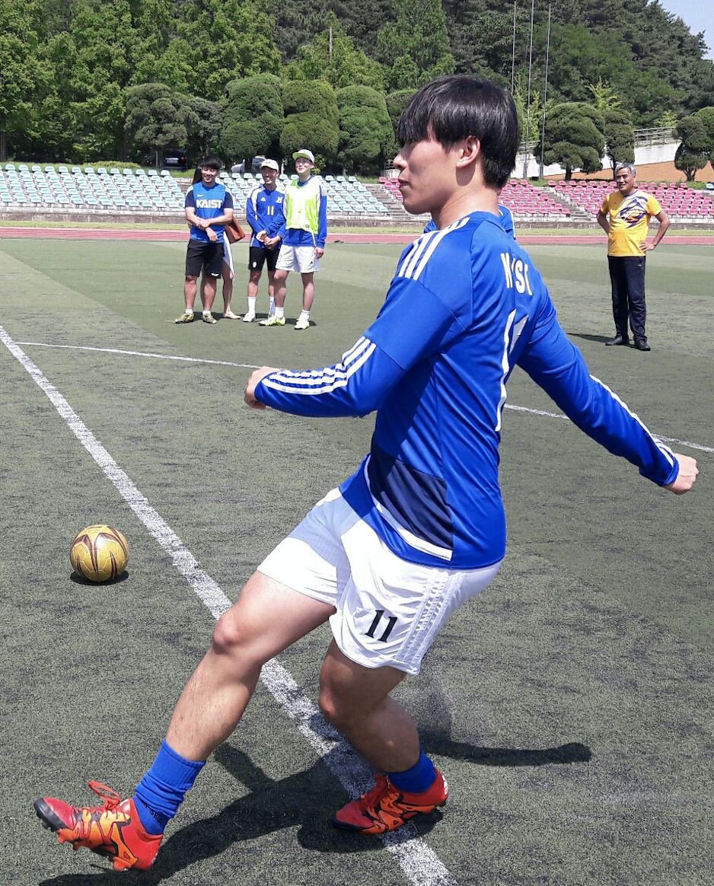
CPA
Course Project Assistant
CS408(F) Computer Science Project
Team Hurricane
Advisor: Juho Kim
Hyunsu Hyungrok
Notes:
Good afternoon,
Welcome to Team Hurricane’s mid-term presentation. My name is Hyunsu and this is Hyungrok.
Our project title is CPA which stands for Course Project Assistant.

Slide 2
Team Project
CPA: Course Project Assistant
Notes:
First of all, we’d like to say that, since our teammate Yuna took leave of absence, we had to adjust our topic and scope.
To keep track of what we we’ve been engaging on, we did not start from the scratch, but decided to remain in previous topic, the management of team projects.
Then, (pause하고 아이컨택ㄲ) we narrowed down our target team.

Slide 3
Team Project
CPA: Course Project Assistant
Management
Notes:
First of all, we’d like to say that, since our teammate Yuna took leave of absence, we had to adjust our topic and scope.
To keep track of what we we’ve been engaging on, we did not start from the scratch, but decided to remain in previous topic, the management of team projects.
Then, (pause하고 아이컨택ㄲ) we narrowed down our target.

Slide 4
What kind of Projects?
CPA: Course Project Assistant
Not too long or too short period (1 month ~ 1 semester)
Two to Six members
Open-ended (short-term research / presentation)
Strongly course-related
Tasks with strict deadline (presentation, report)
Notes:
So these are the properties of our target.
The most unique property of our target is that it’s strongly course-related.
Tasks that will be done throughout the project are given with strict deadline.
And from now on, we will call such projects as a “course project”.
You may recall which projects we’ll be focusing on.

Slide 5
Course Projects
CPA: Course Project Assistant
Course |  | Topic | Report | Present. | # Members
Landmark Discoveries of cell biology |  | Discovery of RNA interference | X | O | 5
Psychological Philosophy |  | AI: Self identity and Free Will | X | O | 4
Immunology |  | Reengineering CART cells for targeted therapy of autoimmune disease | X | O | 2
Omics Biology |  | CRISPR/Cas9 gene drive system | X | O | 2
Introduction to Machine Learning |  | Motion Capture Using Subspace Clustering | O | O | 2
Technology Management |  | Types and Patterns of Innovation | X | O | 3
Introduction to Business Administration |  | Human resource management in Google | O | O | 3
Nuclear Waste Management |  | Selection of waste storage site | X | O | 4
Nuclear Power Plant Design and Project |  | Improving the safety of nuclear power plants | X | O | 4
Multidisciplinary Capstone Design |  | Perturbation-resistant Camera App. | O | O | 6
Notes:
These are the examples of course projects.
I asked my friends what kind of course projects one took:
At first glance, you can see that there are various kinds of courses that assigns “course project” that I’ve just defined.

Slide 6
Storyboard
CPA: Course Project Assistant
Notes:
Now, here’s the team of four students who gets to do the “course project”.
They introduced themselves, and

Slide 7
Storyboard
CPA: Course Project Assistant
Notes:
Of course, they first made kakao chat room right after exchanging phone number or kakao id.

Slide 8
Storyboard - Scene #Google Docs
CPA: Course Project Assistant
Notes:
Hyungrok, who’s a member of the team, suggested to use Google Docs to manage their project.

Slide 9
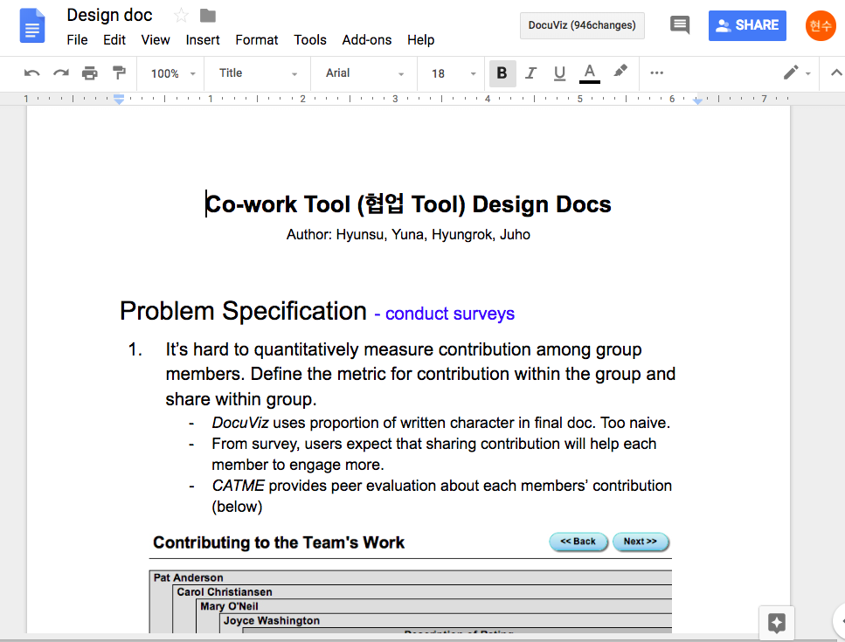
Storyboard - Scene #Google Docs
CPA: Course Project Assistant
Notes:
Everyone agreed, and they wrote many documents such as design documents,

Slide 10
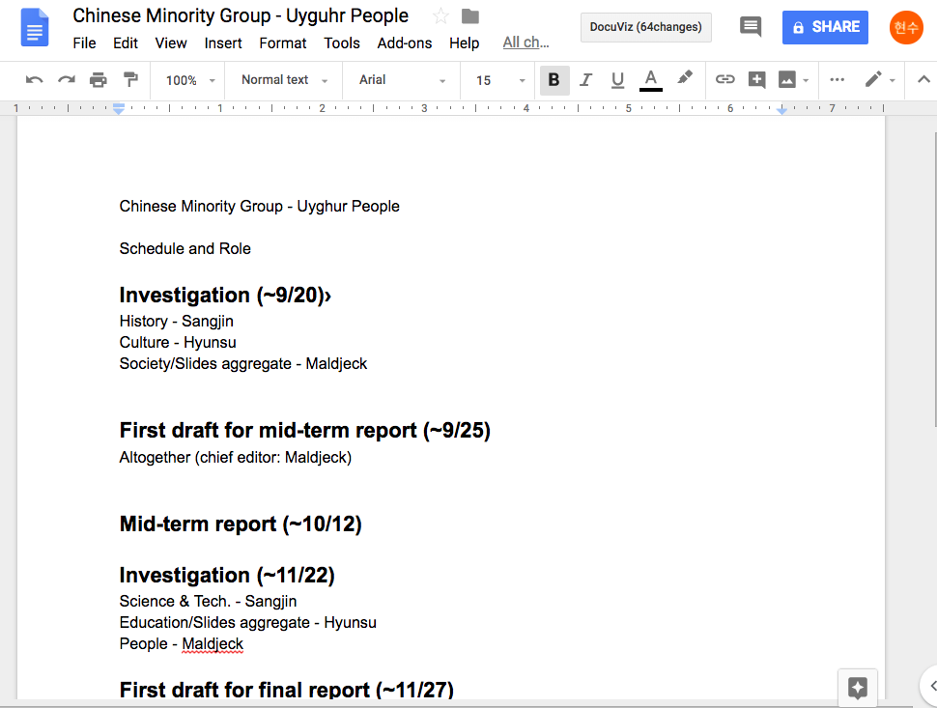
Storyboard - Scene #Google Docs
CPA: Course Project Assistant
Notes:
Schedule and role

Slide 11
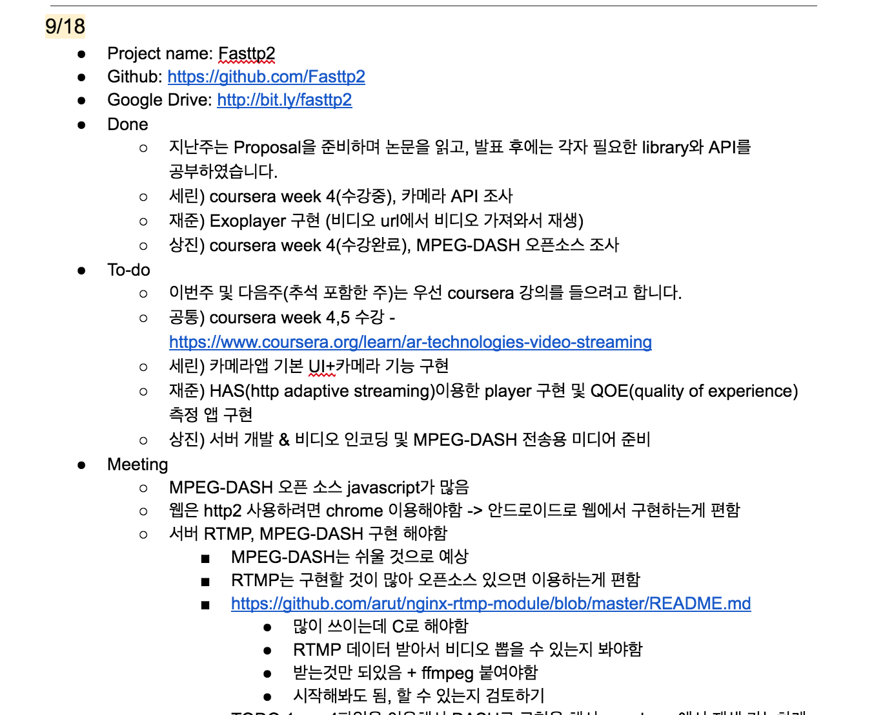
Storyboard - Scene #Google Docs
CPA: Course Project Assistant
Notes:
Keeping their meeting

Slide 12
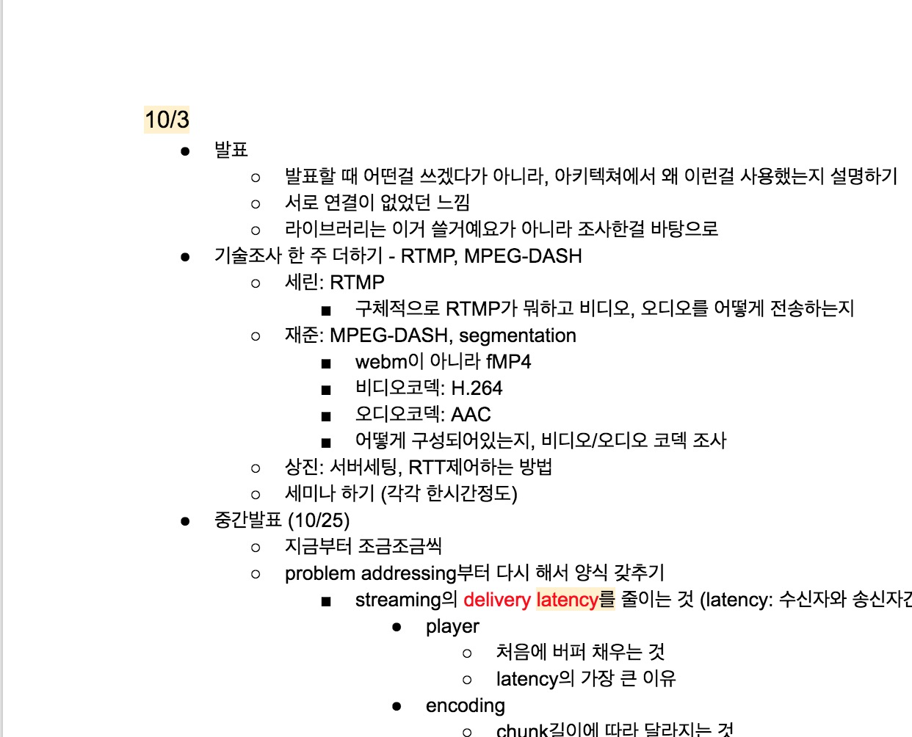
Storyboard - Scene #Google Docs
CPA: Course Project Assistant
Notes:
And detailed goals. It was just fine to use since using Google Docs is so simple.
Anyone could make a document then copy-and-paste it in their chat room.

Slide 13
Storyboard - Scene #Google Docs
CPA: Course Project Assistant
...
Notes:
As your team discusses about the project as well as stacking documents in chat room,
One may experience desperate scroll to the top to find the information or the document one needs.
There are search functionality, however, one should remember the exact word.
Also, there are announcement functionality, however most students tend to just chat or copy-and-paste the link to the chat room when they’re in the middle of the discussion.

Slide 14
Storyboard - Scene #Google Docs’
CPA: Course Project Assistant
Notes:
Such inconvenience became less painful, with google drive.

Slide 15
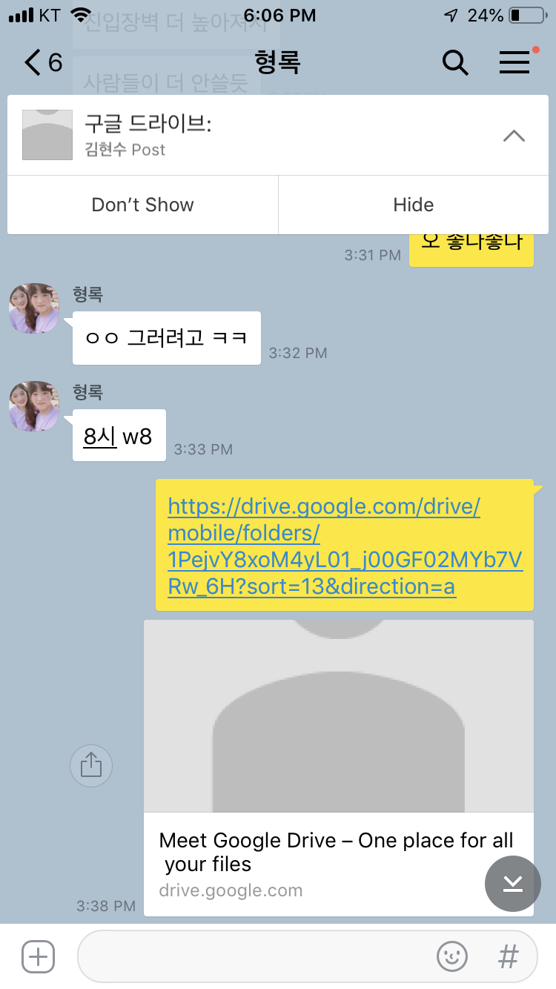
Storyboard - Scene #Google Docs’
CPA: Course Project Assistant
Notes:
Hyunsu made shared directory in Google drive then copy-and-pasted the link in chat room. Also, he set it as an announcement.

Slide 16
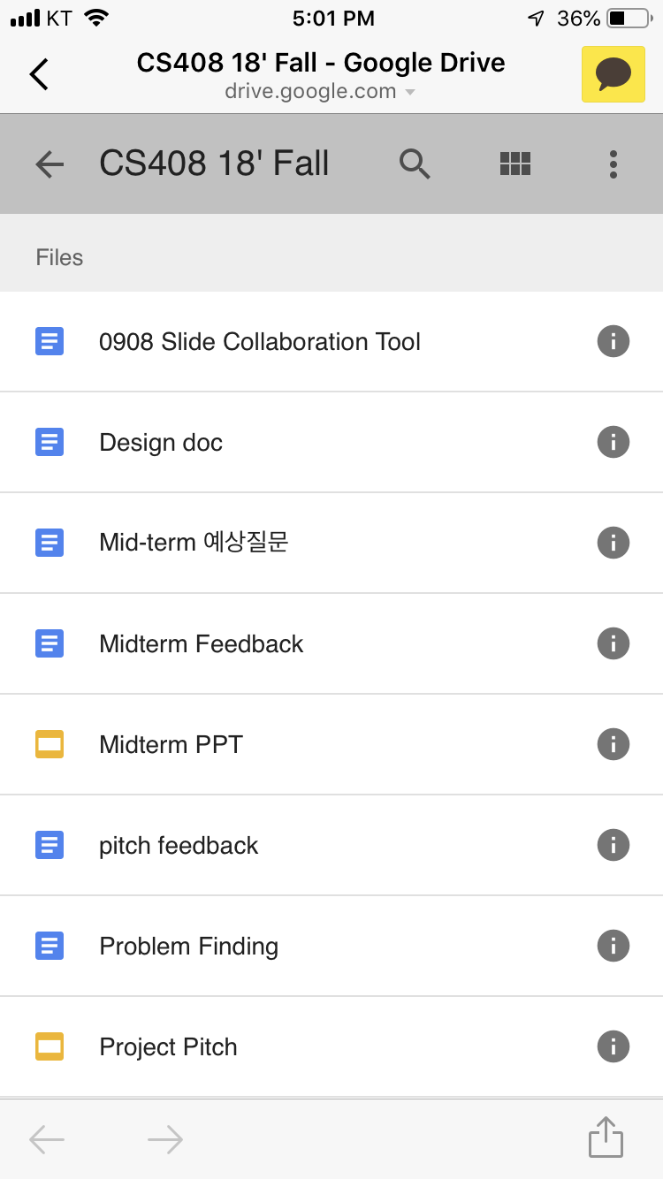
Storyboard - Scene #Google Docs’
CPA: Course Project Assistant
Notes:
As one clicks,

Slide 17
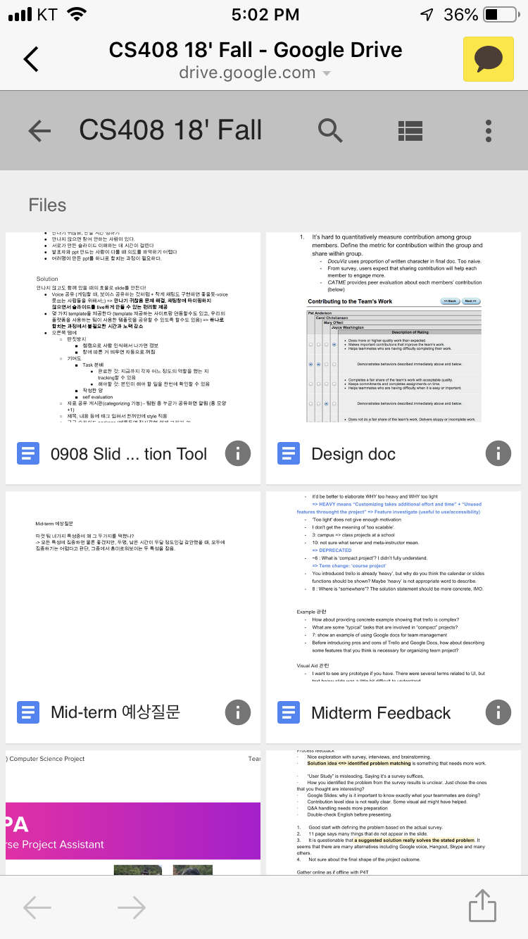
Storyboard - Scene #Google Docs’
CPA: Course Project Assistant

Slide 18
Storyboard - Scene #Google Docs’
CPA: Course Project Assistant
In most cases, not organized
Notes:
They could access easily but usually the drive was not well-organized.

Slide 19
Storyboard - Scene #Trello
CPA: Course Project Assistant
Notes:
Here’s the next team try to use trello.

Slide 20
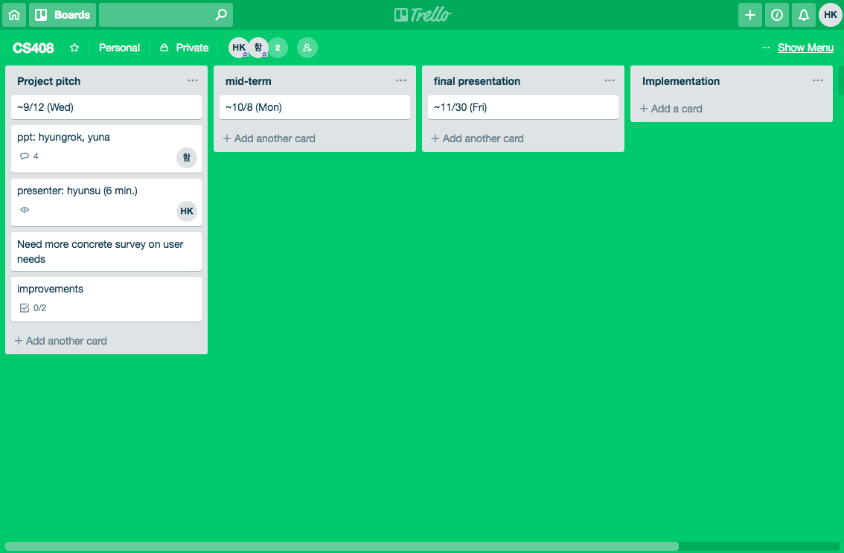
Storyboard - Scene #Trello
CPA: Course Project Assistant
Notes:
Added card for deadline

Slide 21
Storyboard - Scene #Trello
CPA: Course Project Assistant
Notes:
Another card for the roles

Slide 22
Storyboard - Scene #Trello
CPA: Course Project Assistant
Pretty Google Docs
Notes:
Since Trello supports horizontal scroll, It was even hard to browse in mobile web-browser and mobile app where vertical scroll is more natural.

Slide 23
Storyboard - Scene #Trello’
CPA: Course Project Assistant
Notes:
The last team is also trying to use Trello.

Slide 24
Storyboard - Scene #Trello’
CPA: Course Project Assistant
Notes:
They decided to use it since somehow three members have used it and know the convenience using it.

Slide 25
Storyboard - Scene #Trello’
CPA: Course Project Assistant
Notes:
Hyunsu was a newbie to Trello, however agreed to use it.

Slide 26
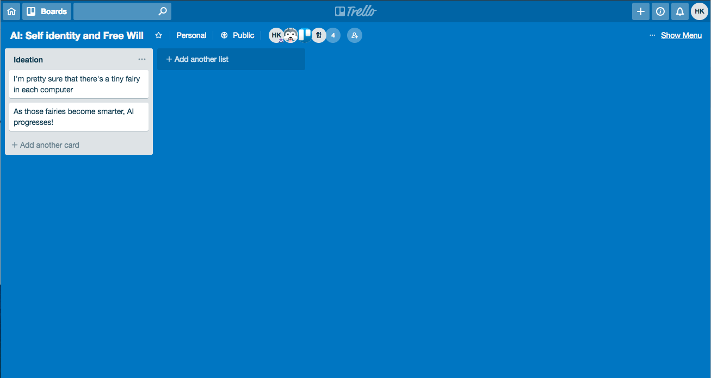
Storyboard - Scene #Trello’
CPA: Course Project Assistant
Notes:
At first, Hyunsu got panic with the blank screen and don’t know what to do at first.
However, since Hyunsu is a steady learner, he followed trello tutorial and was able to make

Slide 27
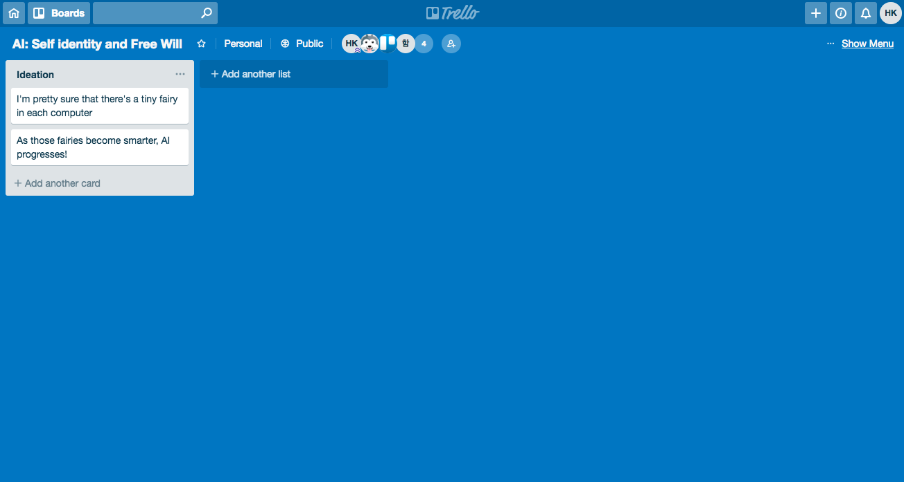
Storyboard - Scene #Trello’
CPA: Course Project Assistant
Notes:
List and cards successfully! It was because the tutorial was about how to make list and cards

Slide 28
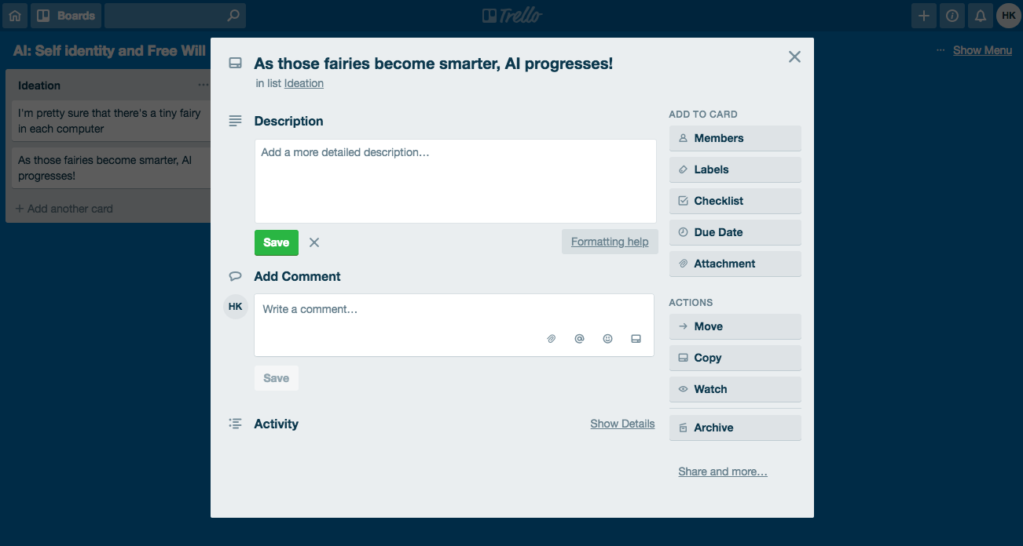
Storyboard - Scene #Trello’
CPA: Course Project Assistant
Notes:
Then it took two weeks to fully understand the features.

Slide 29
Storyboard - Scene #Trello’
CPA: Course Project Assistant
Notes:
Move and Copy features were not needed since there are usually zero connection between any two courses projects.

Slide 30
Storyboard - Scene #Trello’
CPA: Course Project Assistant
Notes:
Still don’t know what this archive is for.

Slide 31
CPA: Course Project Assistant
Solution
Notes:
So the team working on course projects wanted to find better solution for their course projects.
They googled and found:

Slide 32
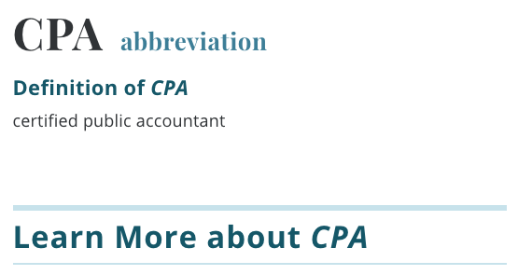
Solution
CPA: Course Project Assistant
Notes:
CPA, not Certified Public Accountant

Slide 33
Solution
CPA: Course Project Assistant
Project management tool; more intuitive and accessible than Trello,
more functional than Google Docs
Notes:
So our solution is providing project management tool somewhere in between trello and google docs.
In other words, we will provide project management tool that is lighter than trello and more functional than google docs.

Slide 34
Solution
CPA: Course Project Assistant
Project management tool; more intuitive and accessible than Trello,
more functional than Google Docs
Notes:
CPA, Cool!
Lets learn more about CPA.

Slide 35
Solution
CPA: Course Project Assistant
Mobile-friendly
Set up milestones based on working period
Peer assessment
Notes:
So, our detailed solutions are this.
We will provide mobile friendly environment.
And we will provide setting up milestones based on working period.
And we will provide peer evaluation at each milestones.

Slide 36
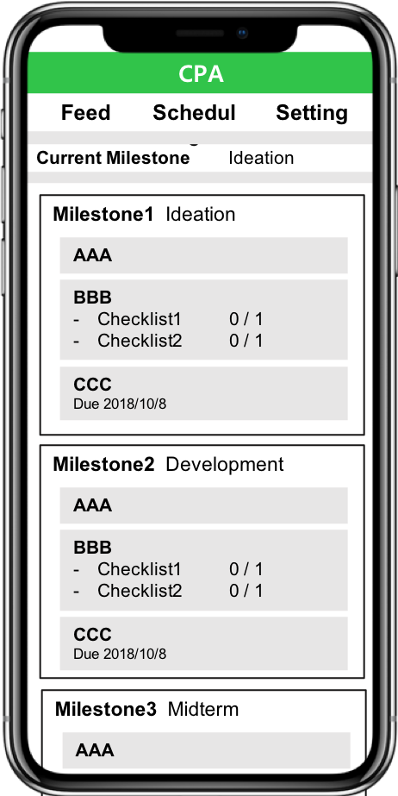
Solution - Overview
CPA: Course Project Assistant
Notes:
This is brief overview of our solution.
Let me explain detail about it.

Slide 37
Solution - Mobile Friendly Environment
CPA: Course Project Assistant
Notes:
Mobile browsing is important feature.
In case of cs students, mobile browsing might not be important since they always bring their laptop.
However, most of students bring their smartphone not laptop.
Therefore, easy browsing in mobile is useful feature for other students.

Slide 38
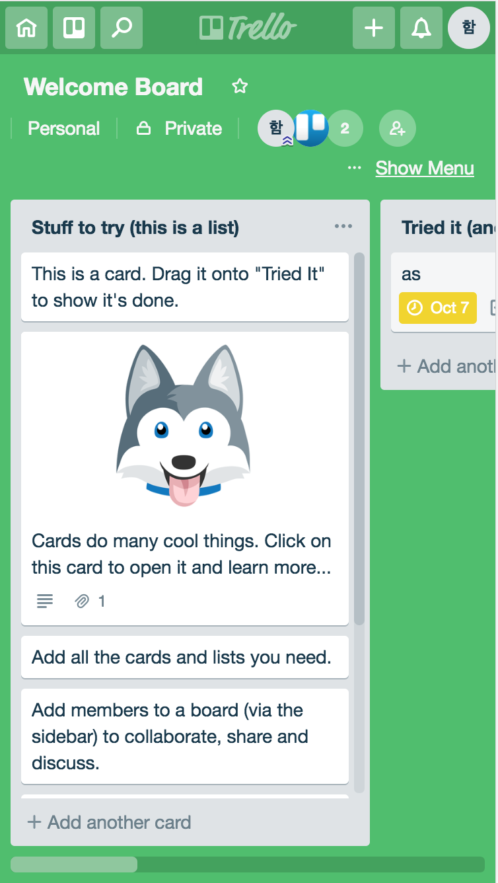
Solution - Mobile Friendly Environment
CPA: Course Project Assistant
Notes:
This pictures explains how trello works.
Trello has horizontal view and uses drag and drop to change position of todo list.
However, we think that those are not mobile friendly features.

Slide 39
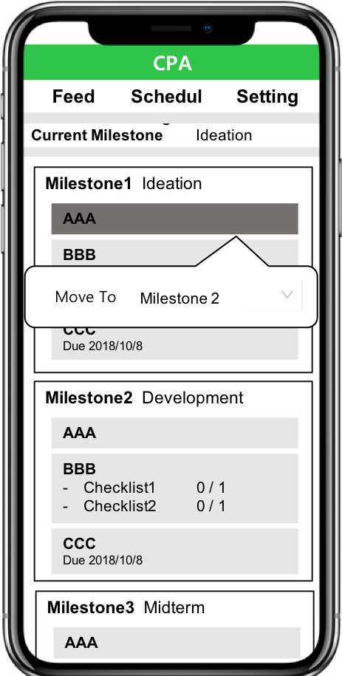
Solution - Mobile Friendly Environment
CPA: Course Project Assistant
Notes:
Therefore, we will respectively change them to vertical view and button.

Slide 40
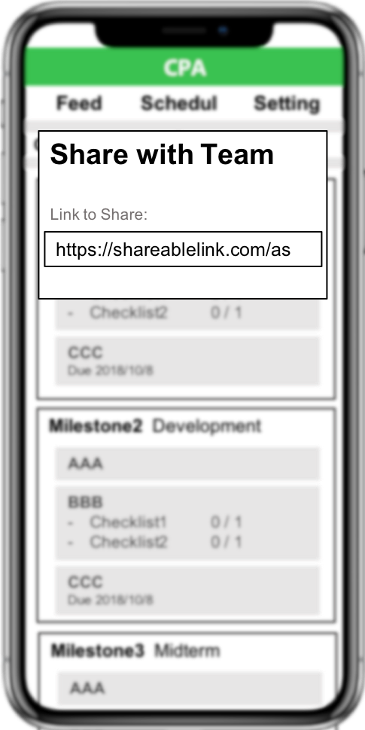
Solution - Mobile Friendly Environment
CPA: Course Project Assistant
Notes:
Also, we will provide easy accessible link like google docs so that users can share its link at KAKAOTALK.

Slide 41
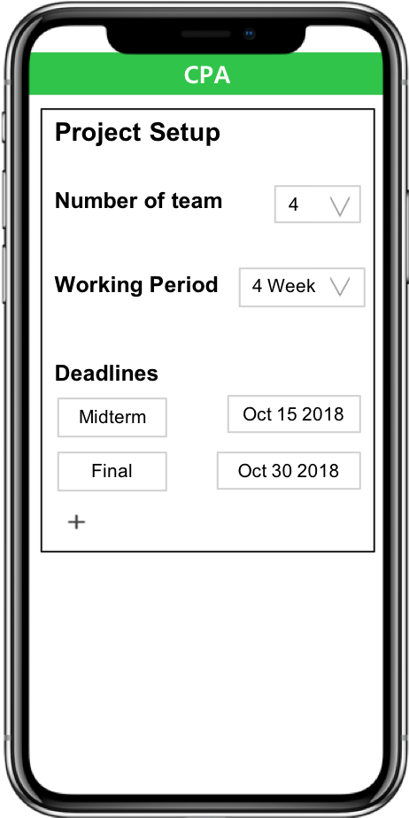
Solution - Provide Milestone
CPA: Course Project Assistant
Notes:
In order to use other working management tools, users need to set lots of things that is troublesome.
So, we provide generating milestones based on easy settings.
Along the deadline, we set proper default milestones that is necessary for project.
Of course, users can customize those default milestones.

Slide 42
Solution - Provide Milestone
CPA: Course Project Assistant
Example: 4 Weeks / no mid-term presentation / final presentation in last week
Milestone 1: Ideation
MileStone 2: PPT (1st draft)
MileStone 3: PPT (2nd draft), Presentation Preparation
MileStone 4: Wrap-up, Final Presentation
Notes:
For detailed example, let’s assume that user’s settings are 4 week and final presentation.
Then we will generate four milestones like this in default.

Slide 43
Solution - Provide Milestone
CPA: Course Project Assistant
Notes:
Many course project teams do not have common goals when they are organized at first and each teammates have different direction.
Therefore, providing them milestone gives team a direction to progress.
Also, walking through the milestones, teammates can make some common goal at each step.
Those common goals can increase teamwork and motivate teammates.

Slide 44
Solution - Provide Milestone
CPA: Course Project Assistant
Not too long or too short period (1 month ~ 1 semester)
Two to Six members
Open-ended (short-term research / presentation)
Strongly course-related
Tasks with strict deadline (presentation, report)
Notes:
(시간 없으면 넘기기)
This is the slide we’ve showed before. (한박자 쉬고)
“Providing Milestone” will eventually help the team to organize their work with respect to strict deadlines.

Slide 45
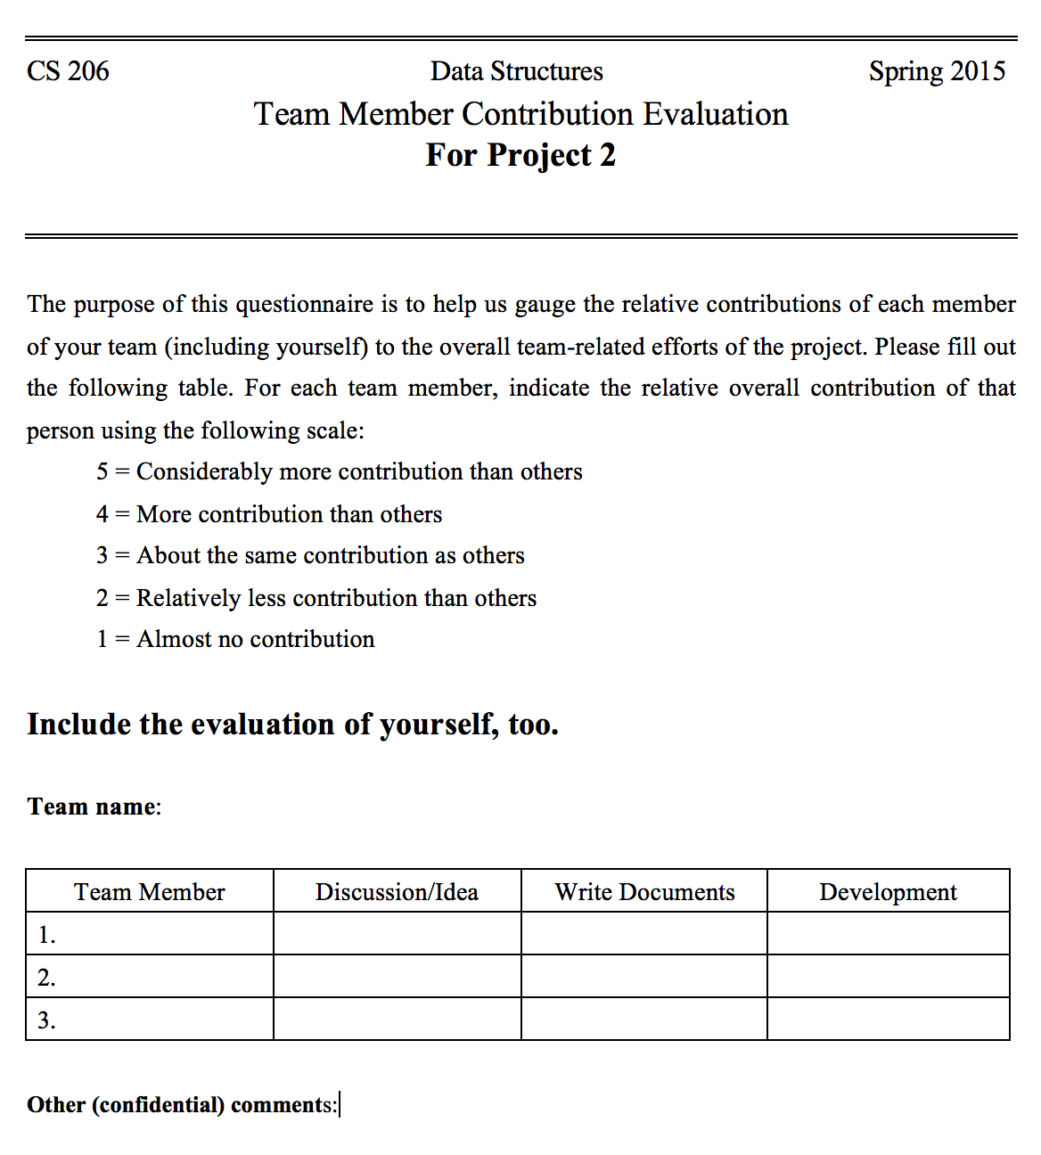
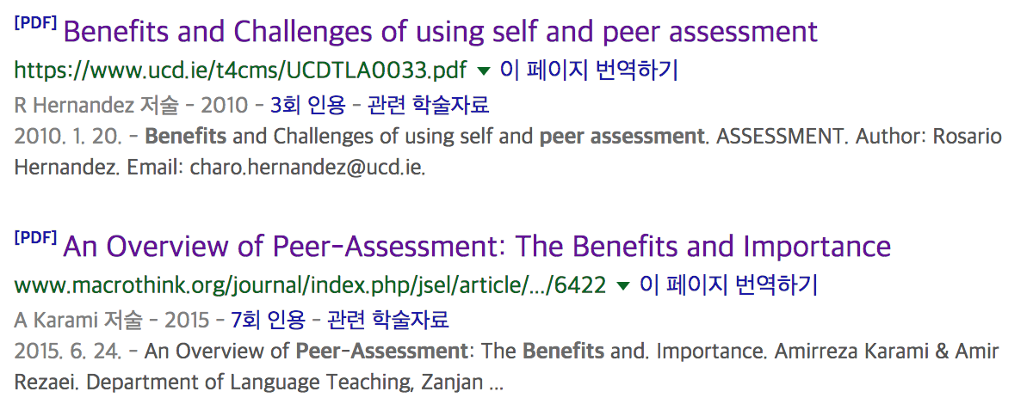
Solution - Peer Assessment
CPA: Course Project Assistant
Notes:
Our solution is making project management tool.
As a management perspective, motivating teammates is important part.
Therefore, we added peer assessment feature.
There are a lot of courses that uses peer assessment.
Left one is peer assessment form of the course that I took.
Also, there are many studies that peer assessment is beneficial to team projects.

Slide 46
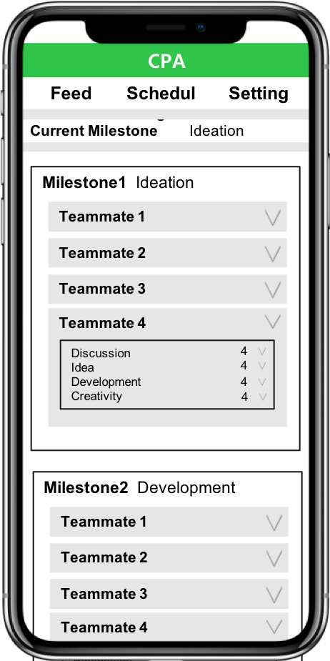
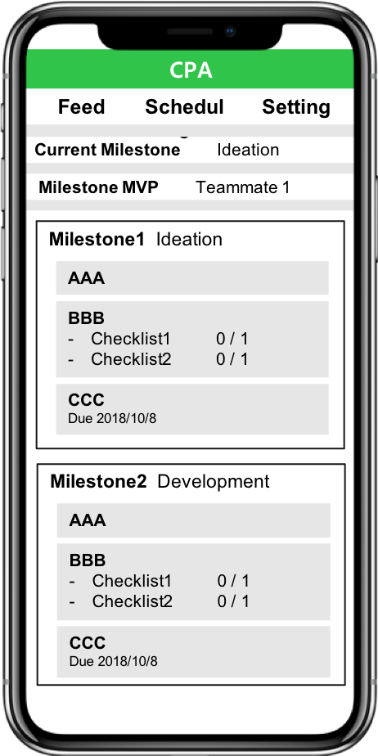
Solution - Peer Assessment
CPA: Course Project Assistant
Notes:
For each milestones, we will provide peer assessment form.
Based on peer assessment result, we will select MVP.
Then, like red box, we will announce MVP of each milestone.
We also consider to visualize statistical result.

Slide 47
Solution - Peer Assessment
CPA: Course Project Assistant
Notes:
Peer assessment motivate teammates since teammates can check their performances.
And it increases productivity of team.
Also, it can be helpful for instructors since instructors can know who did well at each milestone and track each students performances.

Slide 48
Current Status
CPA: Course Project Assistant
Trello Clone Tutorial (In progress)
UI / UX Design (In progress)
Notes:
This is our current status.
We did some trello clone tutorial and UI / UX design.

Slide 49
Milestones
CPA: Course Project Assistant
UI / UX Design
Trello Tutorial
Notes:
Until week 11, we will implement all of our solutions.
Then, we will do some user tests and get feedback.
In week 12 and 13, we will adjust our project along the user feedback and do some code reviews.
In week 14, we will wrap-up our project and prepare for final presentation.

Slide 50
Role
CPA: Course Project Assistant
Hyunsu Kim
Lead Developer
Overall Architecture
UI/UX Design and Implementation
HyungRok Ham
Sub Developer
Functionalities
User Test
Notes:
This is our role.
Hyunsu will lead development and I will support him.

Slide 51
CPA: Course Project Assistant
Manage Course Projects with
C P A
Notes:
We hope you manage your course projects with CPA.
Thank you for listening.

Slide 52
CPA: Course Project Assistant
Appendix

Slide 53
Storyboard - Scene #Google Docs
CPA: Course Project Assistant
Course |  | Topic | Report | Present. | # Members
Landmark Discoveries of cell biology |  | Discovery of RNA interference | X | O | 5
Psychological Philosophy |  | AI: Self identity and Free Will | X | O | 4
Immunology |  | Reengineering CART cells for targeted therapy of autoimmune disease | X | O | 2
Omics Biology |  | CRISPR/Cas9 gene drive system | X | O | 2
Introduction to Machine Learning |  | Motion Capture Using Subspace Clustering | O | O | 2
Technology Management |  | Types and Patterns of Innovation | X | O | 3
Introduction to Business Administration |  | Human resource management in Google | O | O | 3
Nuclear Waste Management |  | Selection of waste storage site | X | O | 4
Nuclear Power Plant Design and Project |  | Improving the safety of nuclear power plants | X | O | 4
Multidisciplinary Capstone Design |  | Perturbation-resistant Camera App. | O | O | 6
Notes:
I asked how many docs and slides did you keep working on each project?

Slide 54
Storyboard - Scene #Google Docs
CPA: Course Project Assistant
Course |  | Topic | # Docs | # Slides | # Members
Landmark Discoveries of cell biology |  | Discovery of RNA interference | 2 | 2 | 5
Psychological Philosophy |  | AI: Self identity and Free Will | 3 | 2 | 4
Immunology |  | Reengineering CART cells for targeted therapy of autoimmune disease | - | 2 | 2
Omics Biology |  | CRISPR/Cas9 gene drive system | - | 1 | 2
Introduction to Machine Learning |  | Motion Capture Using Subspace Clustering | 6 | 1 | 2
Technology Management |  | Types and Patterns of Innovation | 4 | 1 | 3
Introduction to Business Administration |  | Human resource management in Google | 5 | 2 | 3
Nuclear Waste Management |  | Selection of waste storage site | 3 | 2 | 4
Nuclear Power Plant Design and Project |  | Improving the safety of nuclear power plants | 2 | 1 | 4
Multidisciplinary Capstone Design |  | Perturbation-resistant Camera App. | >20 | 4 | 6
Notes:
And they replied:
What we found interesting is that each course project includes giving a presentation so that 1 or 2 slides they had to keep. Also, even though the project doesn’t include report submission, each team in average kept 3 to 4 slides

Slide 55
Storyboard - Scene #Google Docs
CPA: Course Project Assistant
Course |  | Topic | # Docs | # Slides | # Members
Landmark Discoveries of cell biology |  | Discovery of RNA interference | 2 | 2 | 5
Psychological Philosophy |  | AI: Self identity and Free Will | 3 | 2 | 4
Immunology |  | Reengineering CART cells for targeted therapy of autoimmune disease | - | 2 | 2
Omics Biology |  | CRISPR/Cas9 gene drive system | - | 1 | 2
Introduction to Machine Learning |  | Motion Capture Using Subspace Clustering | 6 | 1 | 2
Technology Management |  | Types and Patterns of Innovation | 4 | 1 | 3
Introduction to Business Administration |  | Human resource management in Google | 5 | 2 | 3
Nuclear Waste Management |  | Selection of waste storage site | 3 | 2 | 4
Nuclear Power Plant Design and Project |  | Improving the safety of nuclear power plants | 2 | 1 | 4
Multidisciplinary Capstone Design |  | Perturbation-resistant Camera App. | >20 | 4 | 6
3.5 Docs + 1.6 Slides per Team

Slide 56
Storyboard - Scene #Google Docs
CPA: Course Project Assistant
...
Notes:
Thus, this may not be a non-sense at all.

Slide 57
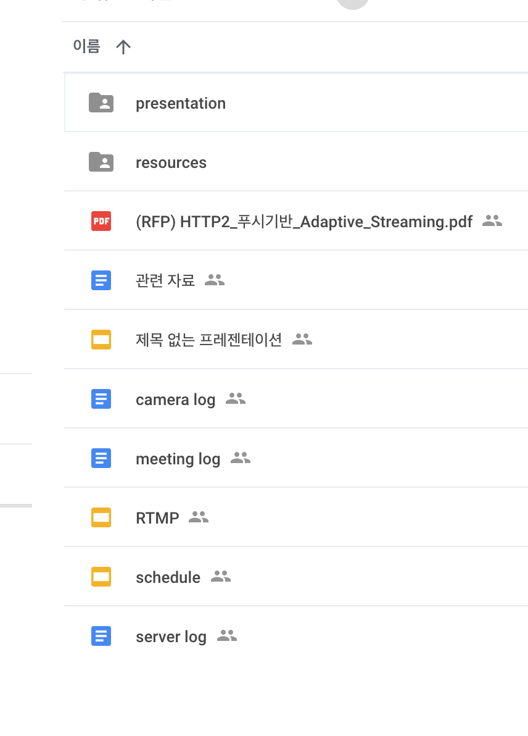
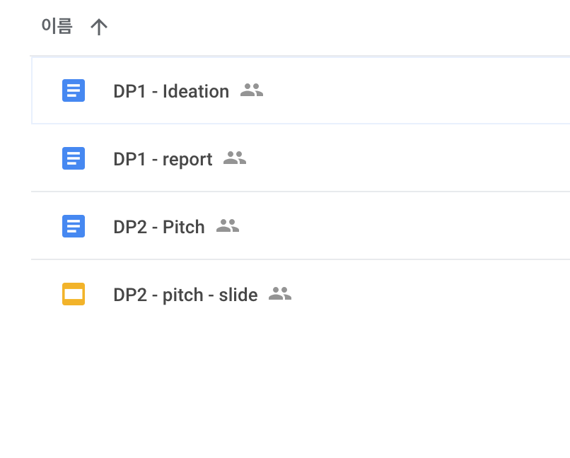
Storyboard - Scene #Google Docs’
CPA: Course Project Assistant
Notes:
You may think that such problem will be easily solved with consistent naming and using additional directories like this:

Slide 58
Storyboard - Scene #Google Docs’
CPA: Course Project Assistant
Good habit :)
Notes:
This is a good habit. We encourage you to do this.
If you feel like it takes additional time and effort to do such thing,

Slide 59
Storyboard - Scene #Google Docs’
CPA: Course Project Assistant
Simpler & Easier,
Provide dir. view with context
Notes:
Naming becomes easily inconsistent as document A was made by member A
And Document B made by the other member B.
Also, if your team is not familiar with google drive, organizing with additional directories may be difficult.

Slide 60
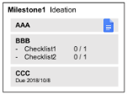
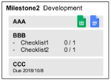
Storyboard - Scene #Google Docs’
CPA: Course Project Assistant
Simpler & Easier,
Provide dir. view with context
Notes:
Thus, we

Slide 61
Storyboard - Scene #Google Docs’
CPA: Course Project Assistant
Simpler & Easier,
Provide dir. view with context
Notes:
구글 닥스를 저번엔 A가 만들었따가, 이번엔 B가 만들었다가 하면서 네이밍 통일이 어렵다.
조마다 구글 드라이브 디렉토리 사용이 어려운 조원들이 있을것이다.

