Slide 1
WebSpector:
JavaScript Execution Monitor
20160655 | Minyeop Choi
20150078 | Gyeongwon Kim
20150349 | Jihee Park
Advisor | Sooel Son

Slide 2
Problem statement
There are no services that detect websites which collect sensitive information

Slide 3
Tracking users
Unique ID per user
Need agreement of user

Slide 4
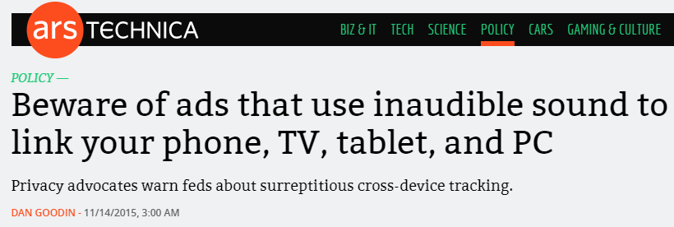
Some websites…

Slide 5
Browser fingerprint

Slide 6
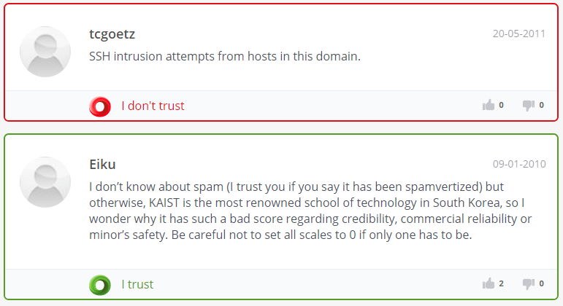
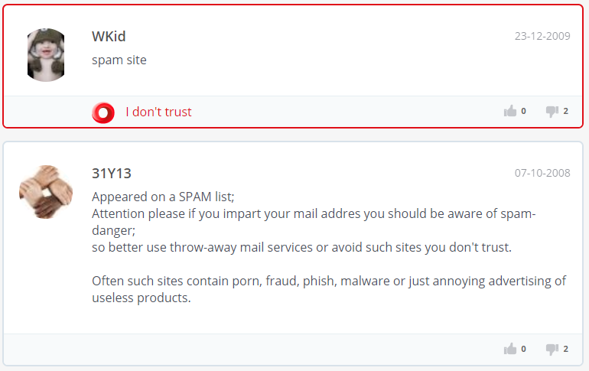
Similar service: WOT
Spamming by KAIST?
SSH Intrusion by KAIST?

Slide 7
Similar service: TOS
TOS; database based on information which
servers THEMSELVES HAVE PROVIDED!
Policy provided by
Servers
are identical to
Actual Policies?

Slide 8
We do not know actual behavior

Slide 9
Technical difficulties
?
Challenging static analysis
Environment-dependent response

Slide 10
Our solution
Visit target website
Monitor JS execution
Prepare various env

Slide 11
Why JavaScript?
???

Slide 12
Brief design
Internet
Proxy
Client worker

Slide 13
Brief design
Internet
Proxy
Client worker
Detected!
Report

Slide 14
Detailed solution design

Slide 15
Detailed solution design

Slide 16
Web application module
Provide reports and statistics to the user from DB
Get inspection request from user and process the request
Database
Web App
User
Query response
Serve
Request Query
Request
Worker master
Request

Slide 17
Detailed solution design

Slide 18
Worker master module
Run client workers with target websites based on user’s request
Web App
Worker master
User Request
Command to visit websites
Request

Slide 19
Detailed solution design

Slide 20
Proxy module
Intercept HTTP/HTTPS response, and replace the original JavaScript with modified one
Collect reports from client and send them to DB module
Client workers
Proxy
JS modifier
Request
Original JavaScript
Response
Modified JavaScript
Report
Database
Report Query

Slide 21
Plan
Now Here!
Design backend / proxy system
Design Web app
Develop backend / proxy system
Develop Web app
Testing &Evaluation
Finalize Project
September
October
November

Slide 22
Plan
Park
Choi
Kim
 |  |  |  | Gantt Chart
 |  |  |  |  |  |  |  | Plan Duration |  |  |  |  |  | Actual Start |  |  |  |  | % Complete |  |  |  |  | Actual (beyond plan)
 | Park | Choi | Kim | ACTIVITY | September |  |  |  |  |  |  |  |  |  |  |  |  |  | October
 |  |  |  |  | 17 | 18 | 19 | 20 | 21 | 22 | 23 | 24 | 25 | 26 | 27 | 28 | 29 | 30 | 01 | 02 | 03 | 04 | 05 | 06 | 07 | 22 | 23 | 24 | 25 | 26
 |  | ● |  | Search for example web application design
 | ● |  |  | Build JavaScript modifier
 | ● |  |  | Build proxy that intercepts script
 |  |  | ● | Design backend system
 | ● | ● | ● | Design web application
 |  |  | ● | Set DB module
 |  | ● |  | Implement demo web application
 | ● |  | ● | Define DB schema
 | ● |  | ● | Implement proxy module
 | ● | ● | ● | Testing (Before MOSP)

Slide 23
Plan
Park
Choi
Kim
 |  |  |  | Gantt Chart
 |  |  |  |  | Actual (beyond plan) |  |  |  |  |  | % Complete (beyond plan)
 | Park | Choi | Kim | ACTIVITY |  |  |  |  |  |  |  |  |  |  | November
 |  |  |  |  | 22 | 23 | 24 | 25 | 26 | 27 | 28 | 29 | 30 | 31 | 01 | 02 | 03 | 04 | 05 | 06 | 07 | 08 | 09 | 10 | 11 | 12 | 13 | 14 | 15 | 16 | 17 | 18 | 19
 |  |  | ● | Set client workers(Windows, Ubuntu, Mac)
 |  |  | ● | Implement worker master module
 | ● | ● | ● | Manual unit test
 |  | ● |  | Build fully functional web application
 | ● | ● | ● | Classify malicious object access pattern
 | ● |  |  | Implement malicious JavaScript detector
 | ● | ● | ● | Optimize whole system
 | ● | ● | ● | Manual integration test and system test
 | ● | ● | ● | Collect dataset
 | ● | ● | ● | Evaluate WebSpector
 | ● | ● | ● | Write final report
…

Slide 24
Progress
JavaScript modifier
60%
Proxy server
100%
DB module
50%
Worker master
0%
Web application
10%

Slide 25
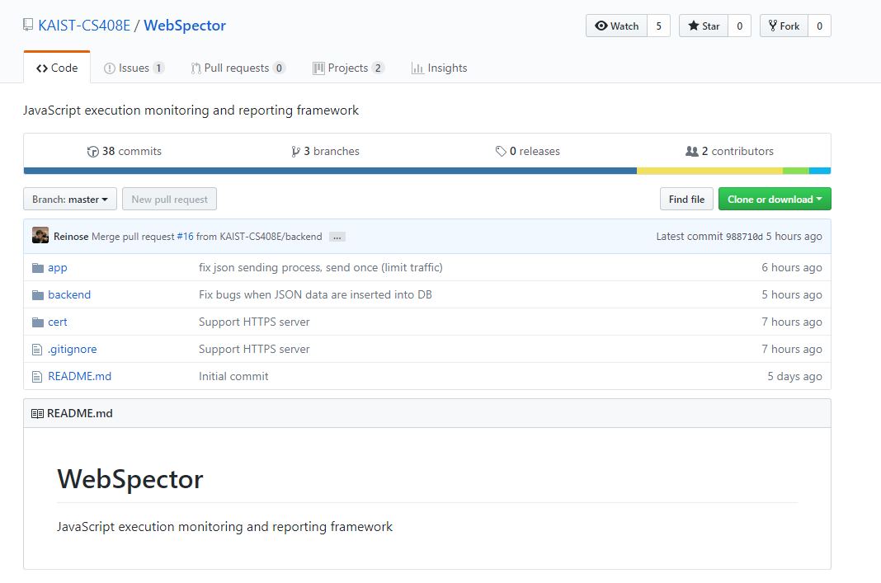
Overall process
https://github.com/KAIST-CS408E/WebSpector

Slide 26
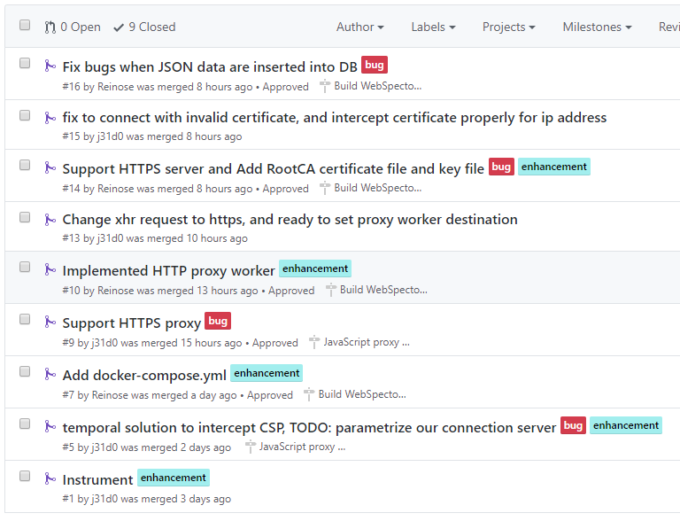
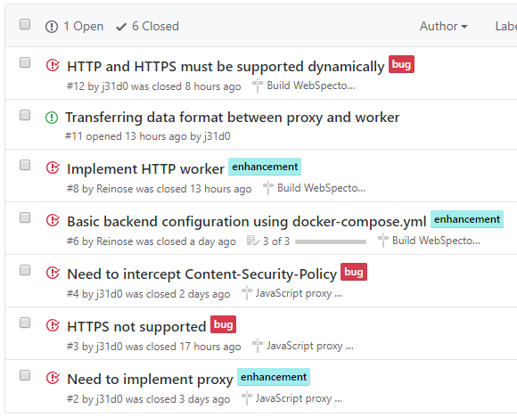
Overall process

Slide 27
Current status

Slide 28
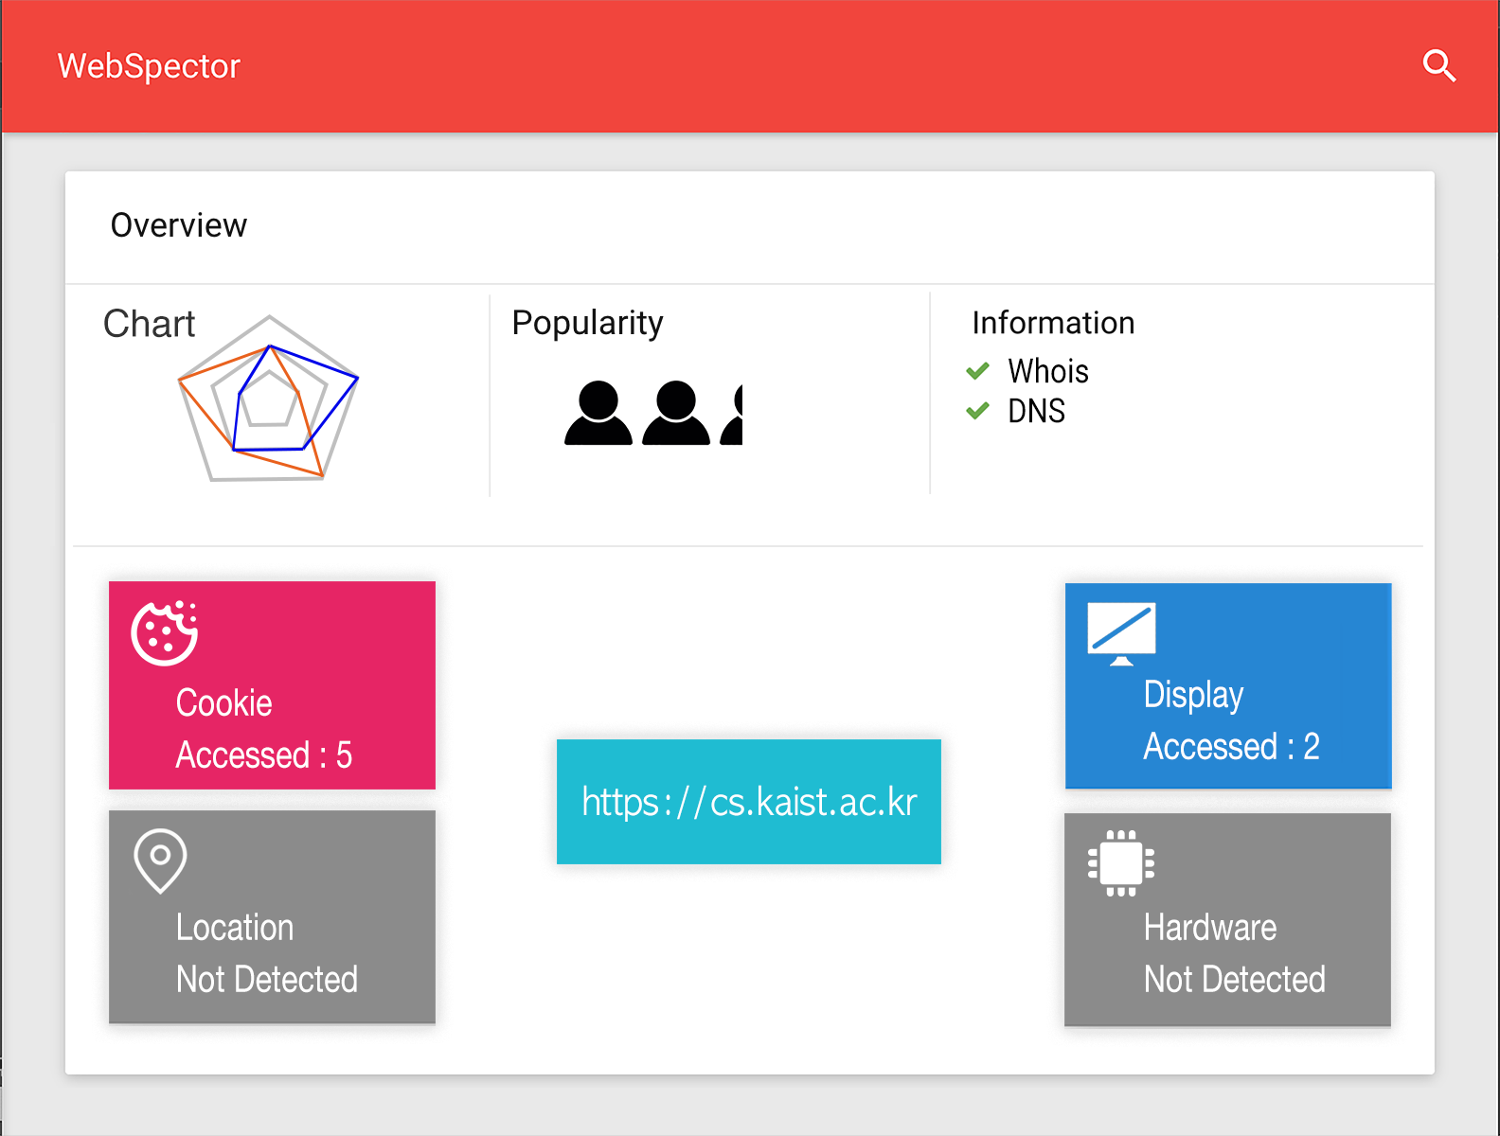
Expected Result

Slide 29
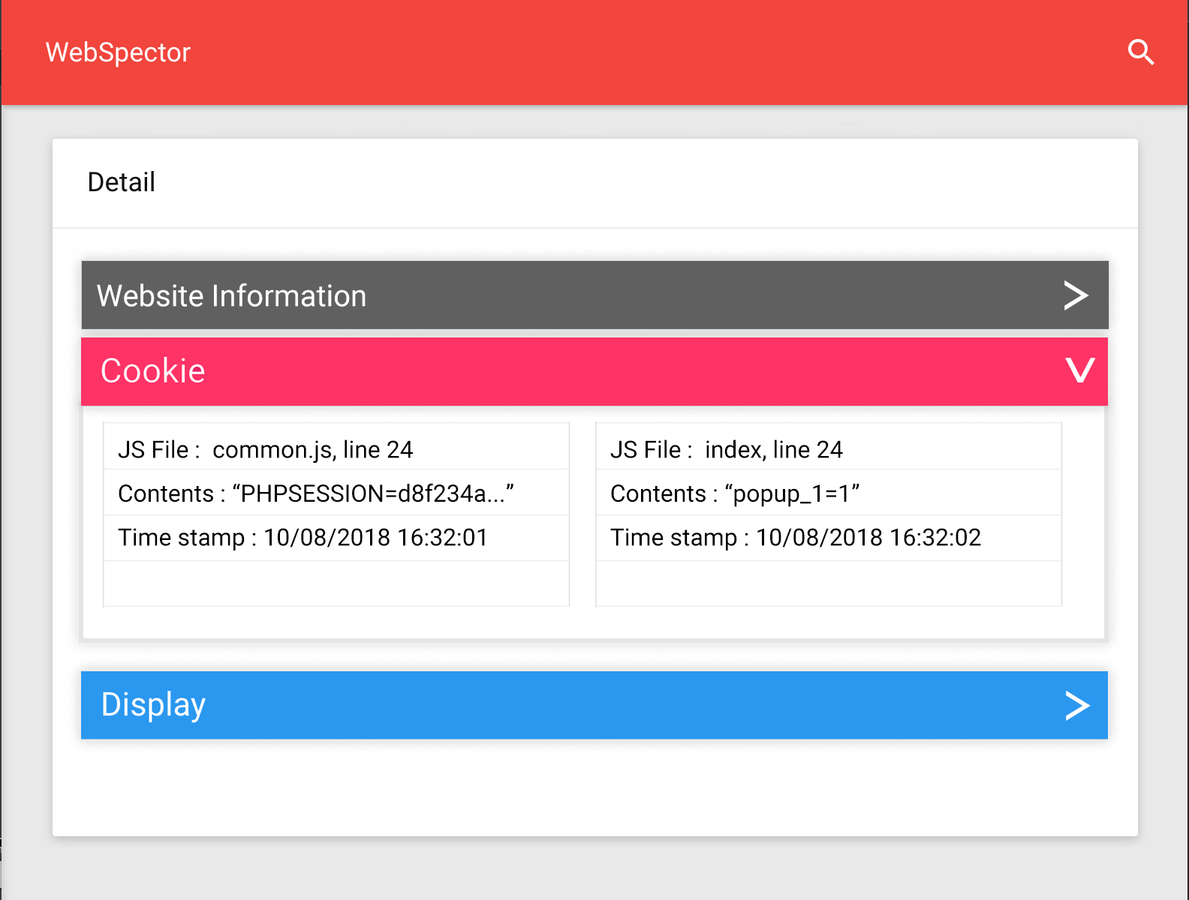
Expected Result

Slide 30
Notes:
This is end of our presentation and thank you for listening. (…3 second) Is there any questions to ask?

