Slide 1
Collaboration Work Flow with Git
Sooel Son

Slide 2
Version Control System (VCS)
Track the history of changes on a project as people collaborate the project together
Why VCS?
Why changes were made?
Code managements in the long term
What changes were made?
Code reviews & education for new comers
Who changed it?
Bug tracking
When changes were made?
Bug triage and release

Slide 3
Centralized Version Control System
SubVersionN (SVN)
Open source version control system founded in 2000 by Collab Inc.
Workflow
1. Pull down any project change from a central server
2. Make changes on the project
3. Commit your changes to the central server.
Notes:
I need a picture here.

Slide 4
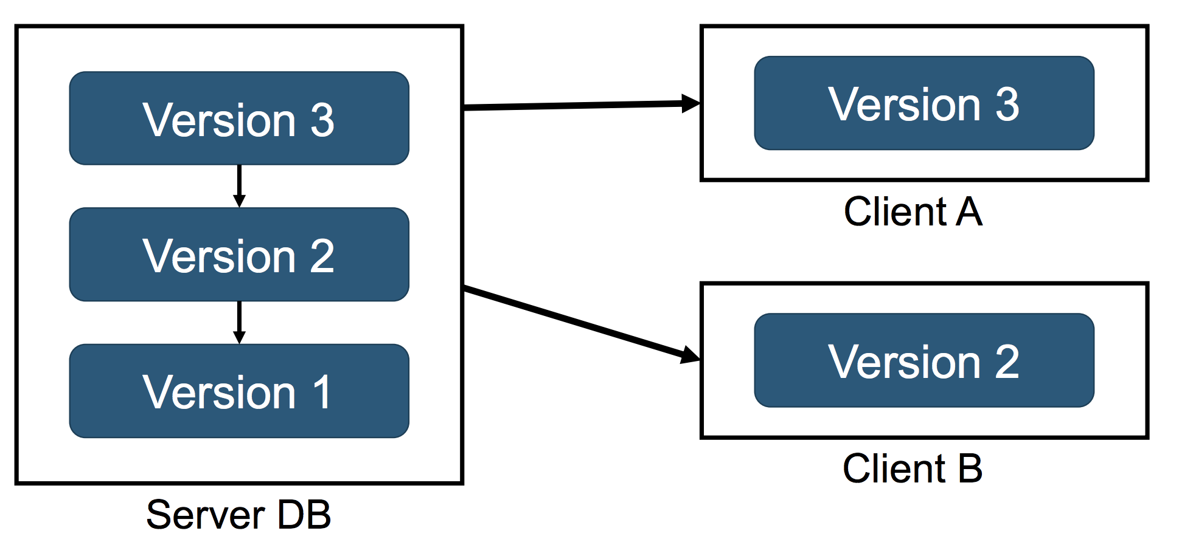
Centralized Version Control System

Slide 5
Centralized Version Control System
Disadvantages
Committing your changes to a remote server is slow.
You always need a network connection for your small changes.
Incomplete(experimental) your code change cannot be committed. (Why?)
Inconvenient to share your incomplete code to get feedbacks from others.
Merging is painful?
Not good for a large project that requires participations from many people!

Slide 6
Distributed Version Control System (DVCS)
Notes:
I need a picture here.

Slide 7
Distributed Version Control System
Disadvantages
May waste server storage when managing large binary files (Hard to be compressed).
Slow Initialization if your project has long historical commit logs
Numerous open-source projects uses Git

Slide 8
What Is Git?
The most popular distributed version control system
Created by Linus Torvalds in 2005
Designed for the development of the Linux Kernel
Collaborate with kernel developers contributing to its initial development
Notes:
코드리뷰는 무엇일까요?
소프트웨어 개발의 일부분

Slide 9
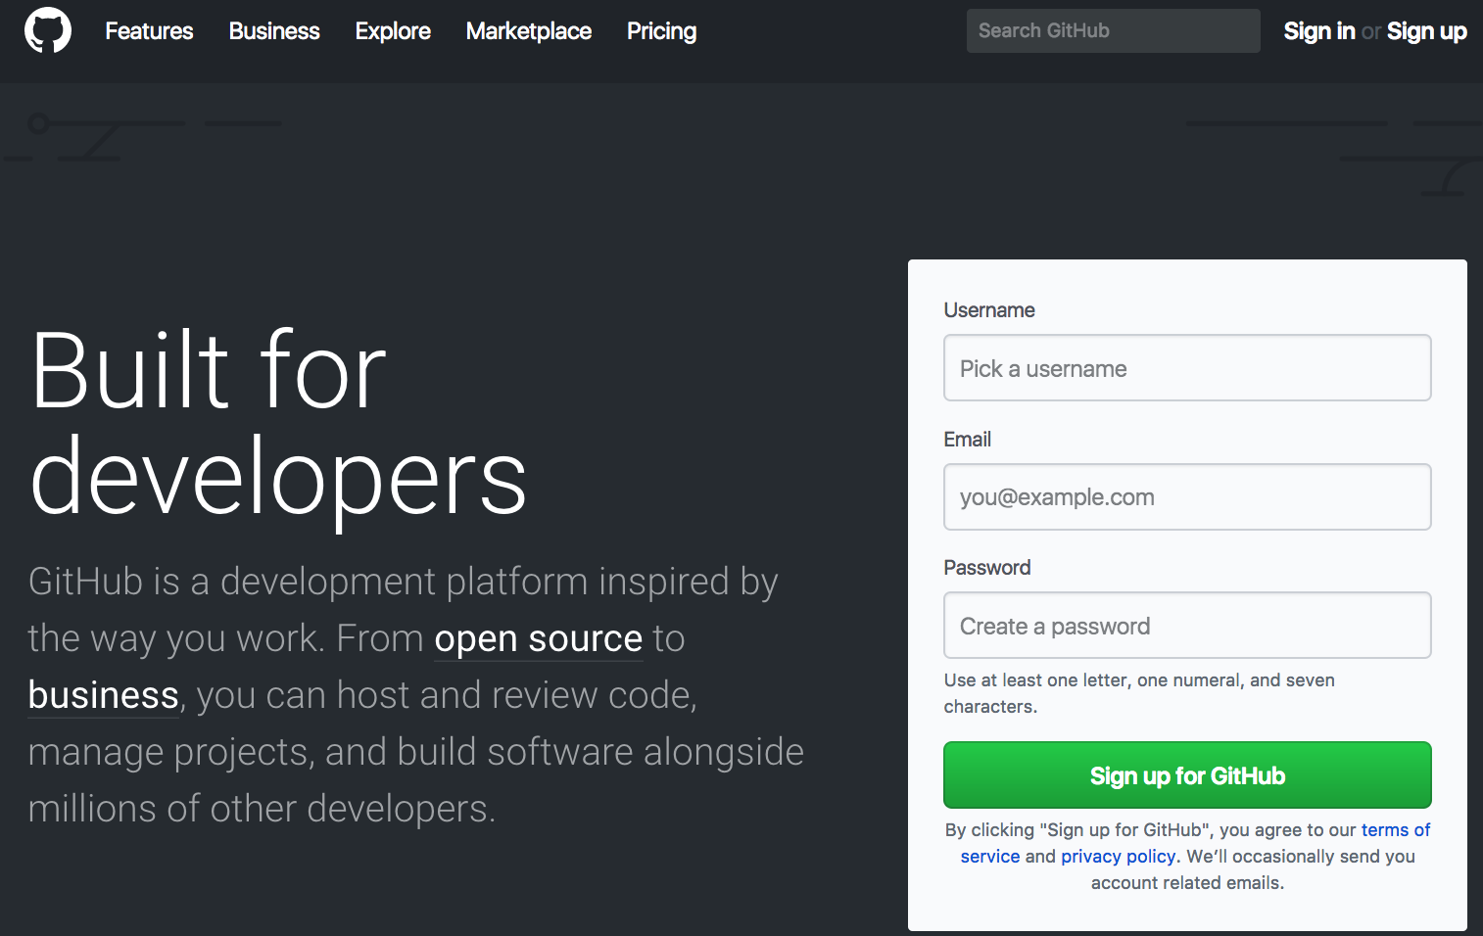
Open your account at https://github.com

Slide 10
Create your repository
Go to "https://github.com/KAIST-CS408E" and click “new”

Slide 11
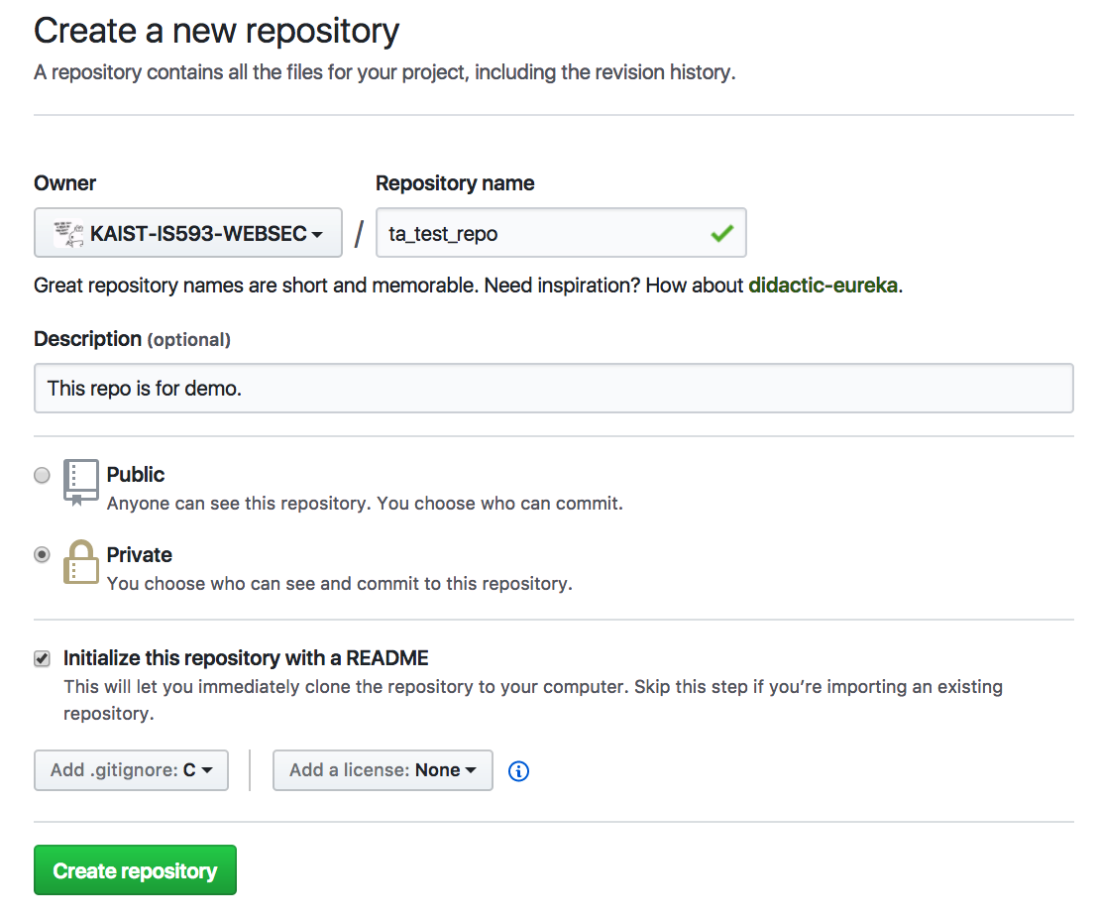
Fill your project info and click create repo.
Choose freely!
Check it! (It is more convenient usually)
Select your programming language

Slide 12
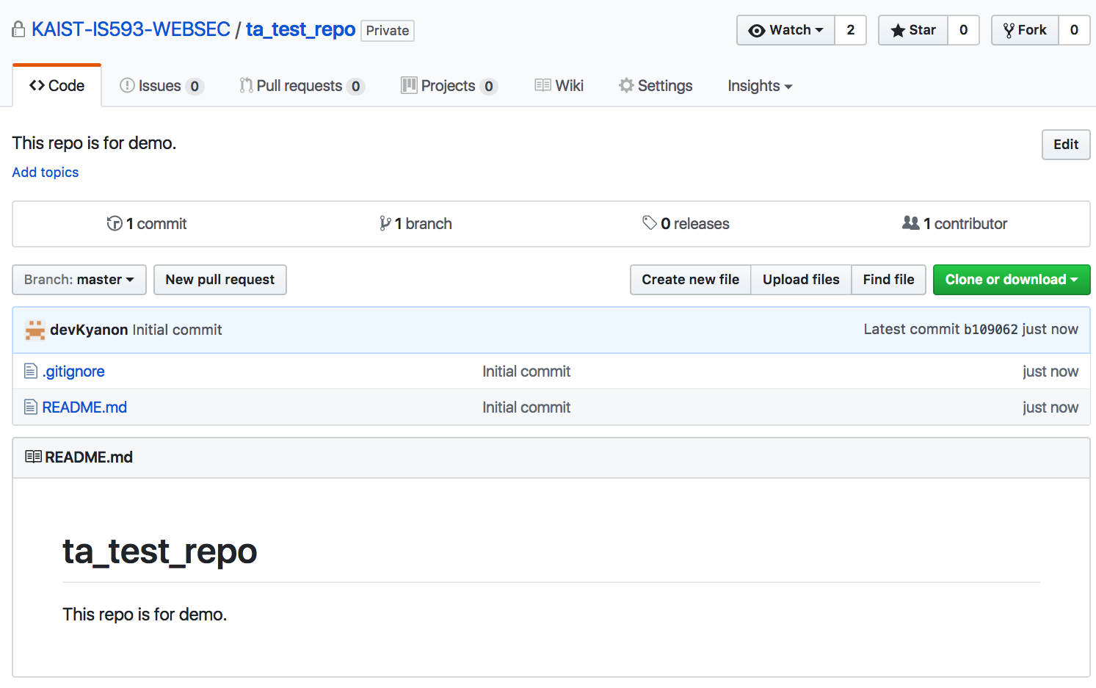
Done! Your repo is created!

Slide 13
Git Workflow
Repository: all your projects files are stored here.
Three stages : Temporary, Local, Remote Repository
Push
Add
Commit
Working Directory (Workspace)
Index (Stage Area)
HEAD (Committed)
GitHub
(Temporary Repo.)
(Local Repo.)
(Remote Repo.)

Slide 14
A File in Git Has 4 Stages
Untracked: the file is not under version control
Modified: the file is modified, but not committed yet
Staged: the file is modified, and marked to be committed in the next commit snapshot
Committed: the file is stored in your local repository

Slide 15
Git Collaboration Models
Using only one branch [master]
Simple & basic usage model
Good for the small teams
Code review workflow
Collaboration models for many open source projects
Convenient for getting feedbacks on your code changes.

Slide 16
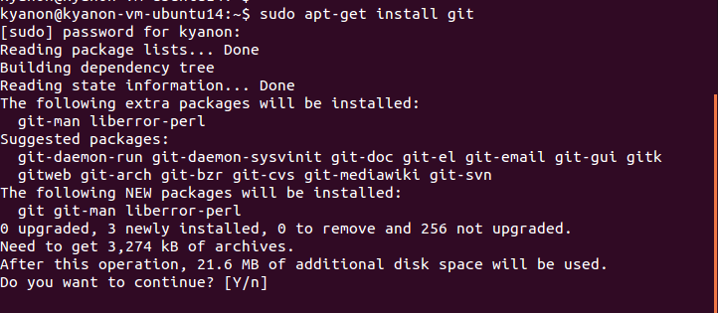
Get your repository (1)
$ sudo apt-get install git

Slide 17
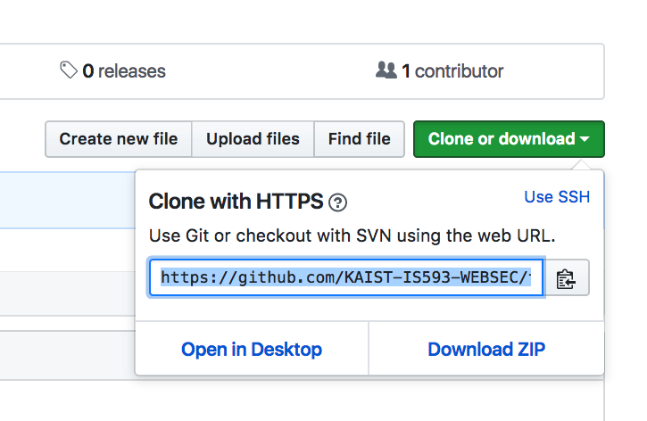
Get your repository (2)
$ git clone [clone URL]

Slide 18
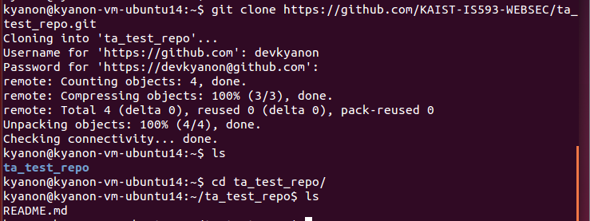
Get your repository (3)

Slide 19
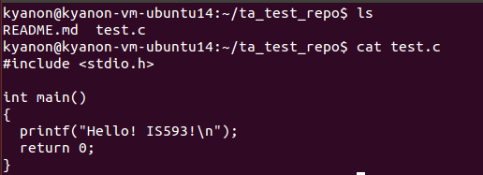
Create Untracked Files
Create a file for your project.
What is the status of test.c?

Slide 20
Create Untracked Files
$ git status

Slide 21
Stage your code change
Stage test.c for the next commit
$ git add test.c

Slide 22
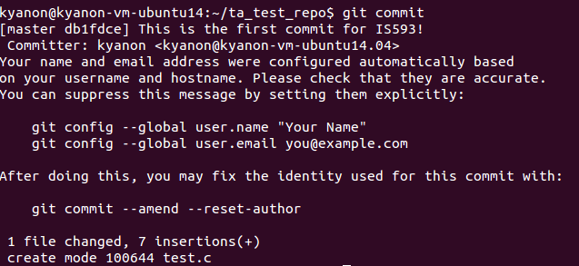
Commit your code change
$ git commit

Slide 23
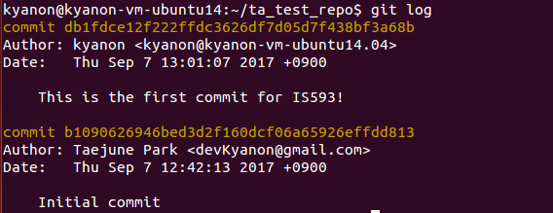
Check your commit log
$ git log

Slide 24
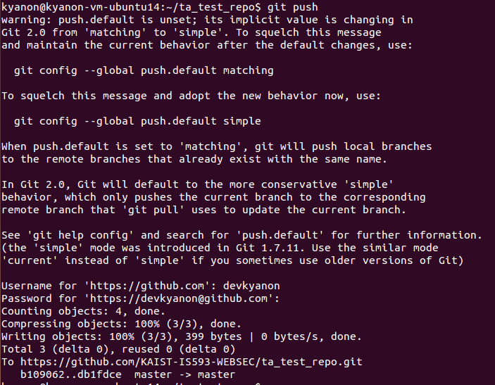
Push your repo to the remote repo
$ git push

Slide 25
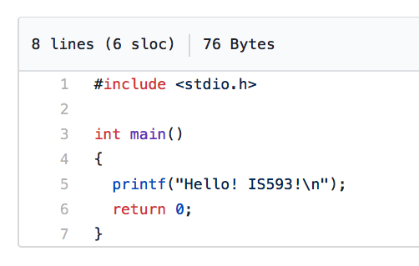
Let’s Check Your Change on the GitHub

Slide 26
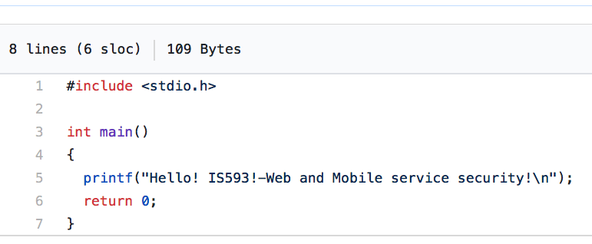
Pull The Latest Changes
Your colleague updated test.c

Slide 27
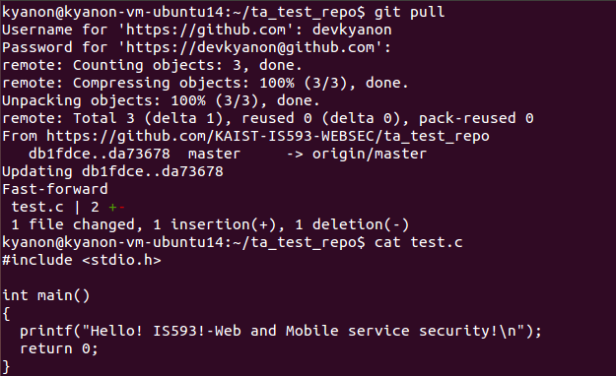
Pull The Latest Changes
$ git pull

Slide 28
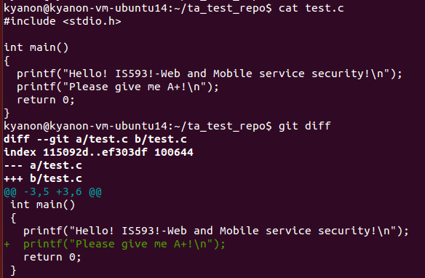
When updating code…
$ git diff
(Working Dir vs Temp Repo)

Slide 29
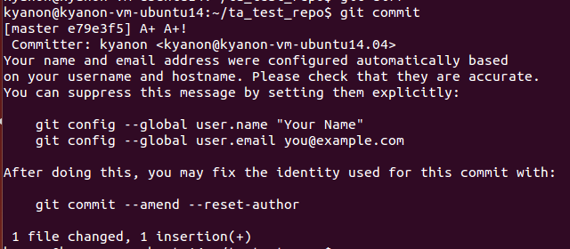
When updating code…
$ git commit

Slide 30
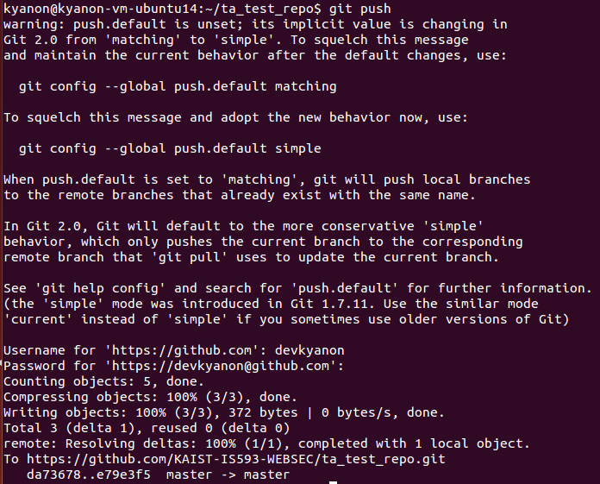
When updating code…
$git push

Slide 31
Git Command Cheatsheet
Get repository: git clone [URL]
Add new files: git add [Files]
Delete files: git rm [Files]
Check status: git status
Commit: git commit
Check commit logs: git log
Upload your repo to GitHub: git push
Download GitHub repo to your PC: git pull

Slide 32
Git Workflow
Workspace
Index
Local Repo.
Remote Repo.
git add
git commit
git commit -a
git push
g it pull or git rebase
git fetch
git checkout HEAD
git checkout
git merge
git diff HEAD
git diff

Slide 33
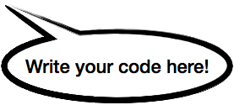
Git Workflow
Workspace
Index
Local Repo.
Remote Repo.
git add
git commit
git commit -a
git push
git pull or git rebase
git fetch
git checkout HEAD
git checkout
git merge
git diff HEAD
git diff

Slide 34
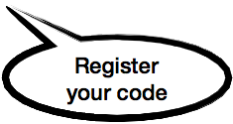
Git Workflow
Workspace
Index
Local Repo.
Remote Repo.
git add
git add
git commit
git commit -a
git push
git pull or git rebase
git fetch
git checkout HEAD
git checkout
git merge
git diff HEAD
git diff

Slide 35
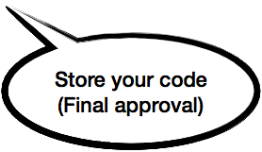
Git Workflow
Workspace
Index
Local Repo.
Remote Repo.
git add
git add
git commit
git commit
git commit -a
git push
git pull or git rebase
git fetch
git checkout HEAD
git checkout
git merge
git diff HEAD
git diff

Slide 36
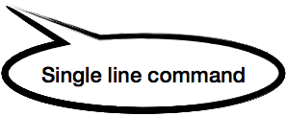
Git Workflow
Workspace
Index
Local Repo.
Remote Repo.
git add
git commit
git commit -a
git commit -a
git push
git pull or git rebase
git fetch
git checkout HEAD
git checkout
git merge
git diff HEAD
git diff

Slide 37
Git Workflow
Workspace
Index
Local Repo.
Remote Repo.
git add
git commit
git commit -a
git push
git push
git pull or git rebase
git fetch
git checkout HEAD
git checkout
git merge
git diff HEAD
git diff

Slide 38
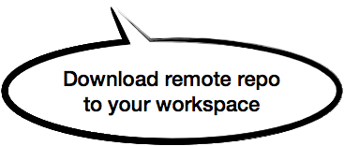
Git Workflow
Workspace
Index
Local Repo.
Remote Repo.
git add
git commit
git commit -a
git push
git pull or git rebase
git pull or git rebase
git fetch
git checkout HEAD
git checkout
git merge
git diff HEAD
git diff

Slide 39
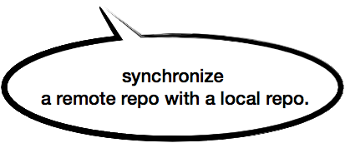
Git Workflow
Workspace
Index
Local Repo.
Remote Repo.
git add
git commit
git commit -a
git push
git pull or git rebase
git fetch
git fetch
git checkout HEAD
git checkout
git merge
git diff HEAD
git diff

Slide 40
Git Workflow
Workspace
Index
Local Repo.
Remote Repo.
git add
git commit
git commit -a
git push
git pull or git rebase
git fetch
git fetch
git checkout HEAD
git checkout
git merge
git diff HEAD
git diff

Slide 41
Git Workflow
Workspace
Index
Local Repo.
Remote Repo.
git add
git commit
git commit -a
git push
git pull or git rebase
git fetch
git checkout HEAD
git checkout HEAD
git checkout
git checkout
git merge
git diff HEAD
git diff

Slide 42
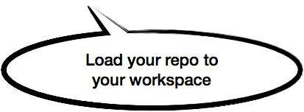
Git Workflow
Workspace
Index
Local Repo.
Remote Repo.
git add
git commit
git commit -a
git push
git pull or git rebase
git fetch
git checkout HEAD
git checkout
git merge
git merge
git diff HEAD
git diff

Slide 43
Git Workflow
Workspace
Index
Local Repo.
Remote Repo.
git add
git commit
git commit -a
git push
git pull or git rebase
git fetch
git checkout HEAD
git checkout
git merge
git diff HEAD
git diff HEAD
git diff
git diff

Slide 44
Git Collaboration Models
Using only one branch [master]
Simple & basic usage model
Good for the small teams
Code review workflow
Collaboration models for many open source projects
Convenient for getting feedbacks on your code changes.

Slide 45
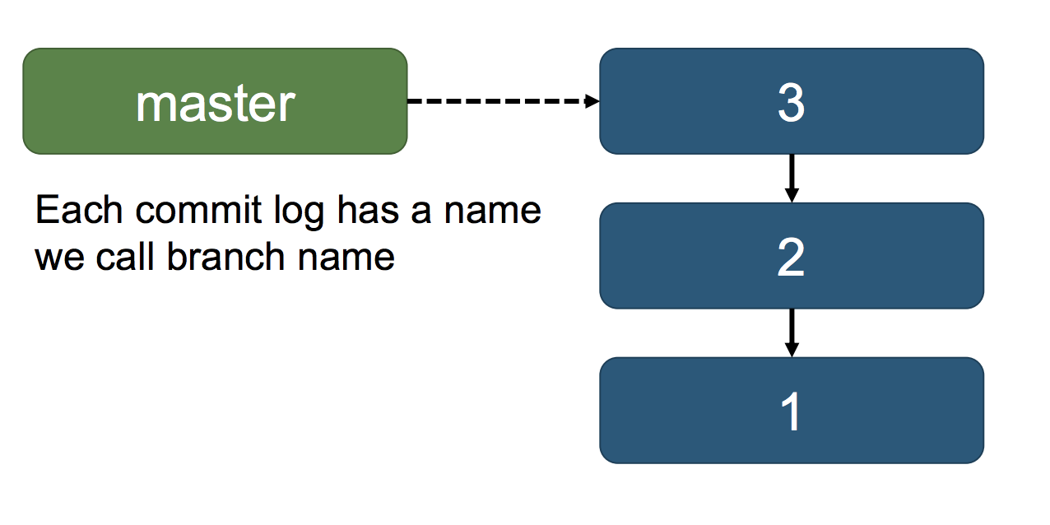
Git Branch
A pointer to one of commits in a repository
By default, you are given a master branch

Slide 46
Code Review Work Flow
1. Prepare your local branch
2. Work on your CL (code change list) on the local branch
3. Commit your CL to the local repo
4. Push your CL to the remote repo
5. Create a pull request for your CL
6. Get code reviews from your team members and improve your CL
7. Iterate 2, 3, 4, 5, 6 until you get LGTM
8. Merge your branch with the base one (master)

Slide 47
WF Step1: Prepare Your Local Branch
Clone or sync your local repository with the origin/master
git clone [Your Clone URL] (Only for the initialization)

Slide 48
WF Step2: Commit Your CL

Slide 49
WF Step3: Push Your CL to The Remote Repo.

Slide 50
WF Step4: Create a Pull Request

Slide 51
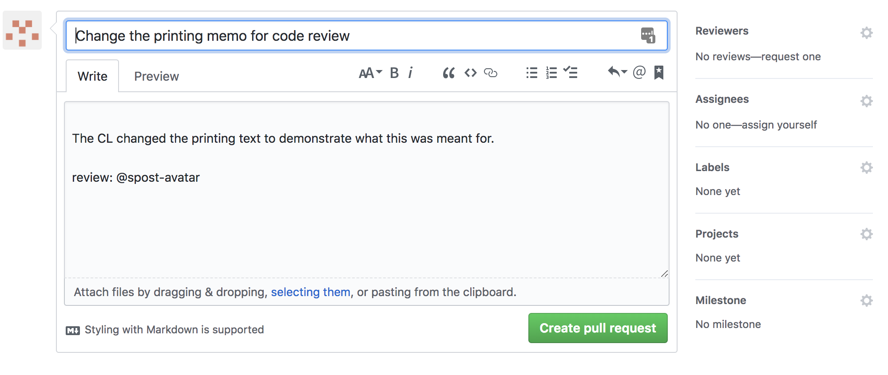

Slide 52
WF Step5: Perform Code Review

Slide 53
Step 6: Revise Your Code & Push it Again

Slide 54
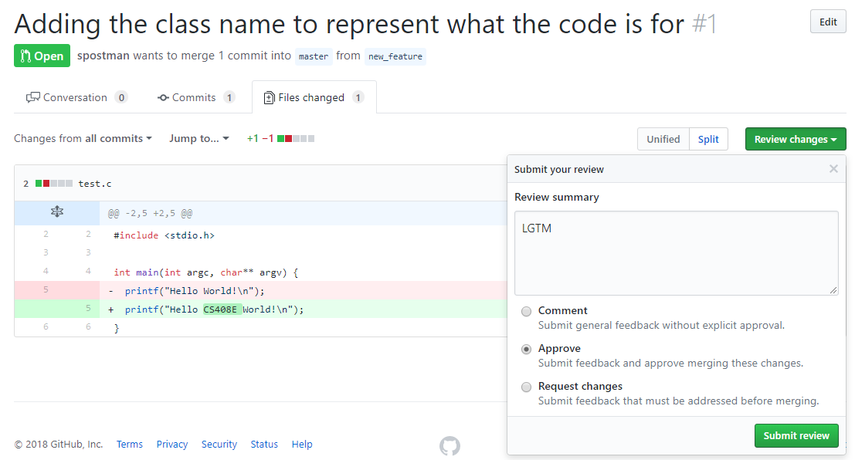
Step 7: Iterate Until You get a LGTM

Slide 55
Step 8. Let’s Merge Yours With Master Branch

Slide 56
You just submitted the CL!

Slide 57
Common Branch Management Scenario #1
Prepare master and dev branch
All development commits are submitted to dev branch
master holds the production version to be released
When the dev code is ready to be released, they are merged into master
Feature branch
It is designed to implement a specific feature
Branching from dev, They are merged into dev
Release branch
It is designed to release a production binary
Branching from dev, They are merged into dev and master
While preparing Release, dev should not be changed (Hopefully!)
Hotfix branch
It is designed to fix a bug for the immediate release
Branching from master, They are merged into dev and master

Slide 58
If your team is too big to handle branches, ….
Prepare master and yourown branch
Each member makes a change to his/her yourown branch
Merge yourown branch into master
No other branch!
The key idea is for your colleagues to see other changes as soon as possible!
If other member makes a mistake, you should see it immediately
If other member implements a feature, your code should be based on the new code base.
https://docs.microsoft.com/en-us/vsts/repos/git/git-branching-guidance?view=vsts

Slide 59
Should we use Git?
Different corporation uses different tools for their code review work flows
Google & Facebook has their own tools and methods
Microsoft uses Git to manage their products and source code
…
Advice: Pick one or two! Use and improve the tools
It takes a time to train employees to learn a tool
Good and convenient tools make code reviews much easier

Slide 60
Summary
Git is a popular distributed version control system
Has been used for many popular open source projects
Code review Git work flow
Create your own workspace and branch
Implement your CL on on your branch
Push your CL to the branch on the remote repository
Create a pull request to the base branch for a code review
After LGTM, merge your pull request to master branch

Slide 61
Google Engineering Practice
Referenced from
Software Engineering at Google, Fergus Henderson
Why Google Stores Billions of Lines of Code in a Single Repository, Rachel Potvin
Google Testing Blog
Test Coverage at Google, Andrei Chirila

Slide 62
Google’s Key Success Factors
Google has been a successful company
Chrome, Android, Google Mail, Google Map, YouTube, Google Translate
Their success is based on many things
Enlightened leadership, smart engineers, a high hiring bar
Excellent software engineering practice

Slide 63
The Source Repository
Most Google’s code is managed by a single unified repository
Accessible to all software engineers at Google
Exceptions
Security-critical projects
Large open-source projects (Chrome, Android)
2015 Statistics
86 terabyte repository
A billion files including 9 million source code files
2 billion LoCs
35 million commit history

Slide 64
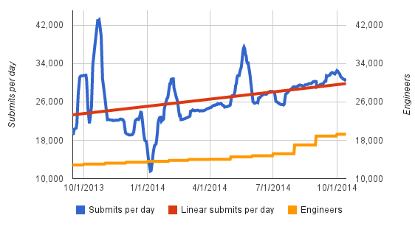
2014 Statistics: 30K checks-ins per day

Slide 65
The Source Repository
Most developers develop at the head of the repository
Because it is NOT a branch, any commit may affect other products
If there is a problem caused by any commit, developers can identity the problem early
Scenario
Developer A refactored the existing code that heavily used by many products.
Product B uses the refactored code and pushes a new release binary to the production
Product B starts crashing in production

Slide 66
The Source Repository
Automated system tests runs continuously
For every single commit to any file in the transitive dependencies of the test
The system notifies the authors and reviewers of any change for which the tests failed
There is a dashboard that shows the current status of each project in the repository (green build, red build)
Scenario
Developer A made a CL, ran all required tests, and then submit the CL.
In the night at MTV, Developer B made a change in her project, but A’s project is dependent on B’s one.
After B’s change, Developer A is getting a series of emails notifying your project is currently failing in compiling and testing.

Slide 67
Code Review
Google has a web-based code review tool
Integrated with email system, and automated static/dynamic analysis
Support side-by-side diffs with user interfaces
Scenario
Developer A completes her CL and sends it for the code review
When sending the code review with CLI commands, the system automatically runs required tests and analysis
The web-based code review tool shows that the current CL passed all necessary analyses and their results

Slide 68
Code Review
All code changes to the main source repository must be reviewed by at least one software engineer.
Usually two software engineers: language readability reviewer and owner
How to choose your reviewers?
You can choose your reviewers
There is a system to decide your reviewers automatically
What if your reviewers take so long to review your CL?
It can slow the development process
Send your complicated CLs to more experienced reviewers
Meet the reviewers in person
Keep your CL short

Slide 69
Testing
Unit testing is strongly encouraged and prevalently practiced
The code review tool highlights source files without tests
Google has automated tools for measuring test coverage, which is available at the code review tool
Dependency injection technique is popular with mock objects
Integration and regression tests are also widely practiced
Scenario
Product A internally uses web server and Bigtable (Cloud NoSQL database) instances
All developers implement their business login in web server instances
How do you guarantee that Product A runs OK although Bigtable logic keeps changing over time?

Slide 70
Testing
Testing coverage for projects
The coverage for each project is measured once per day
The coverage is computed on the code claimed by the project team
Testing coverage for commits
The coverage is measured for each commit at least once
It is a part of code review measured by the internal automatic tool
What is an expected coverage percentage? 85%

Slide 71
Testing
Uncovered code

Slide 72
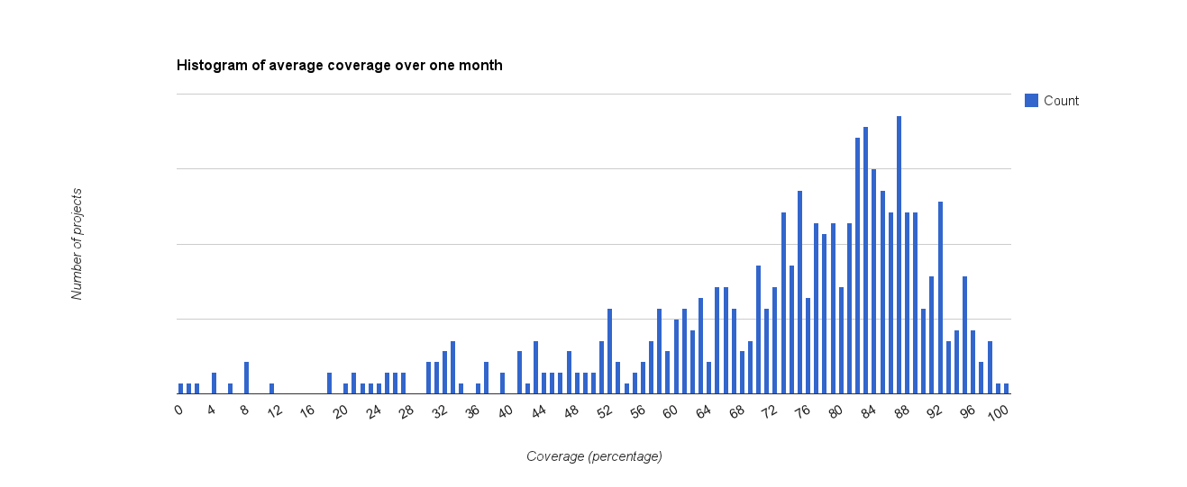
Per-project Coverage
The median is 78%, the 75th percentile 85% and 90th percentile 90%

Slide 73
Bug Tracking
Google has an internal tool called Buganizer
Most teams track their bugs and issues via Buganizer
bugs, feature requests, customer issues, processes (release or clean-ups)
Team members often look up the list of bugs or work items to address
Team leaders often assign such bugs or team members assign bugs to themselves
Many technical debts are also listed here
e.g. refactoring code, change internal libraries to optimized ones
All interested parties are notified via emails for any changes on a filed bug
Once you fix a bug or implement a new feature, close the bug.

Slide 74
Release Engineering
A few teams have a dedicated release engineers
Most teams release their binaries weekly or even daily
How is this possible? (diverse test sets and automated procedures)
Process
A workplace is synced with the latest repository snapshot with green build
The automated system builds a project in the workplace and packages necessary files
A developer pushes the packaged binary to a staging server
For integration tests by small number of users
A developer pushes the packaged binary to one or more canary servers
Minimize the potential risk of all blackouts
Finally push the binary to all production servers

